Slide 1
RANGELAND SUSTAINABILITY:
IS SCIENCE RELEVANT AND WHAT IS NEXT?
Joel Brown (Brandon Bestelmeyer, Kris Havstad and Jeff Herrick contributing)
Jornada Experimental Range
Ignite Session 11
Future Directions of Useable Science for Sustainable Rangelands
Ecological Society of America Annual Meeting
Baltimore MD
12 August 2015

Slide 2
IS SCIENCE RELEVANT?
DO OUR WIDGETS WORK?
vs
HAVE WE CHANGED THE WAY PEOPLE MAKE DECISIONS?

Slide 3
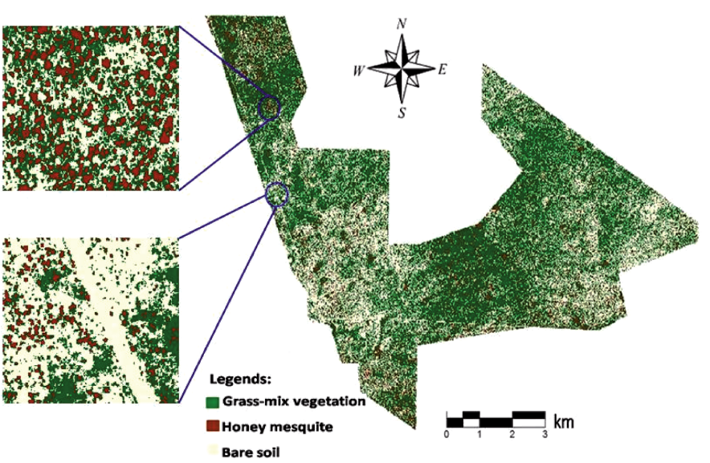
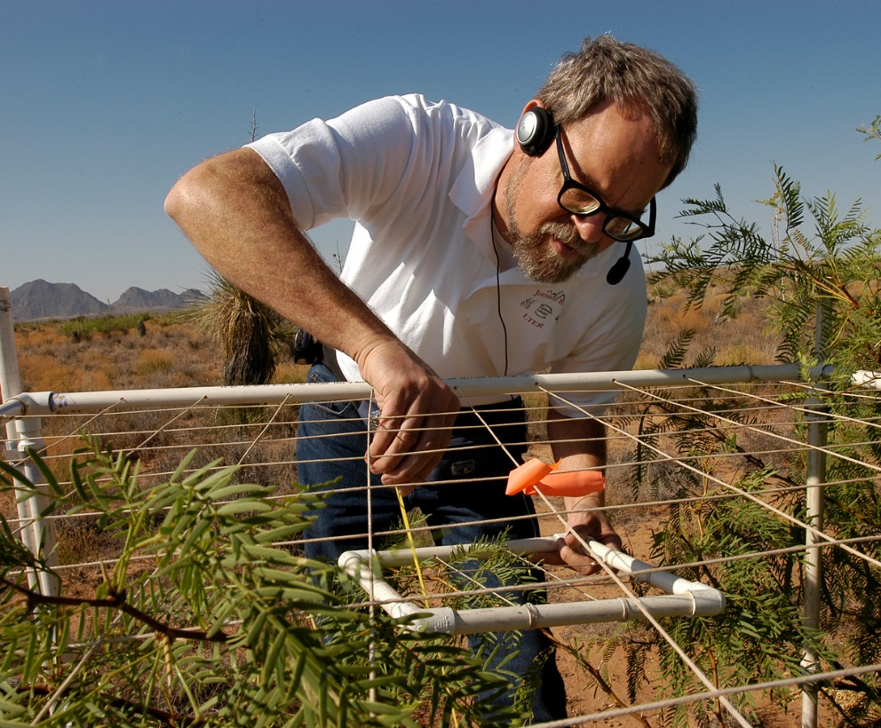
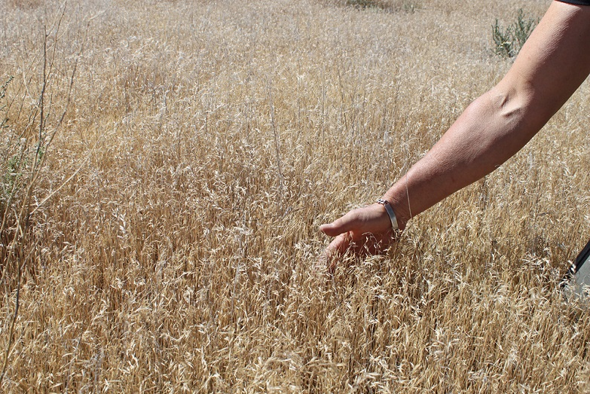
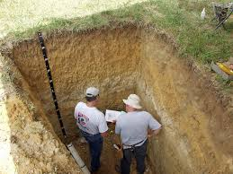
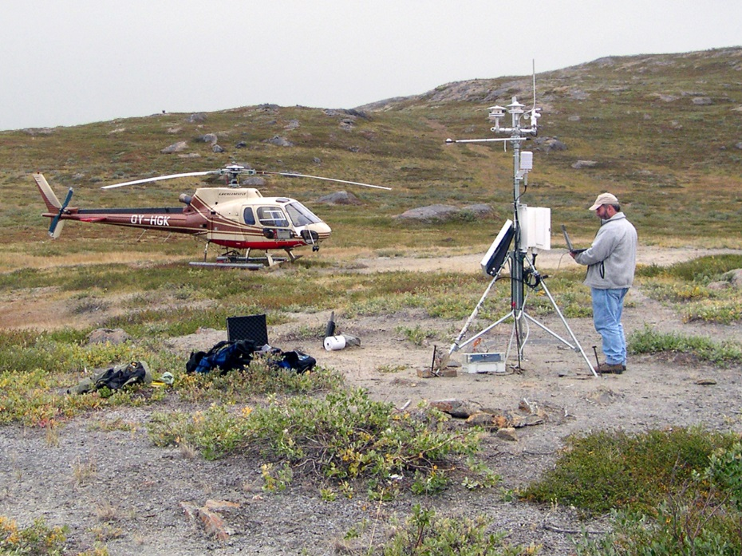
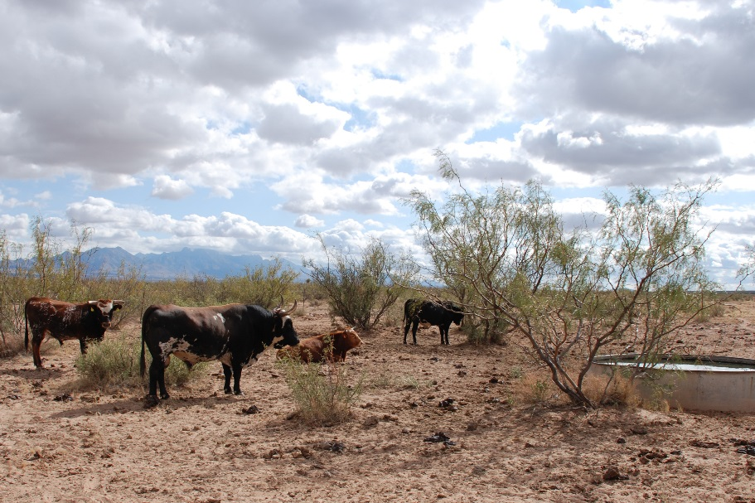

Slide 4
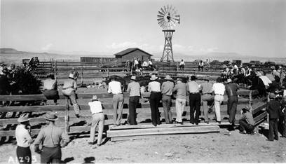
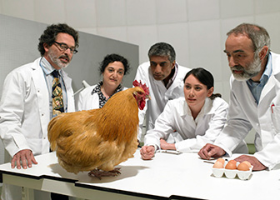
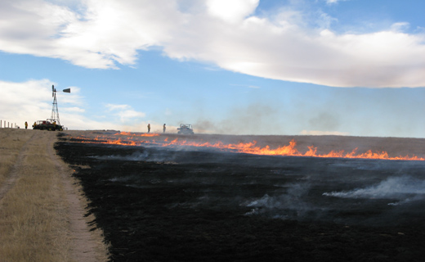
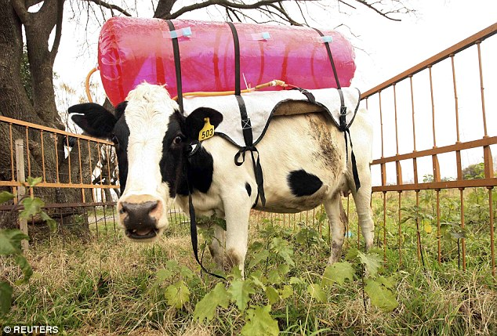

Slide 5
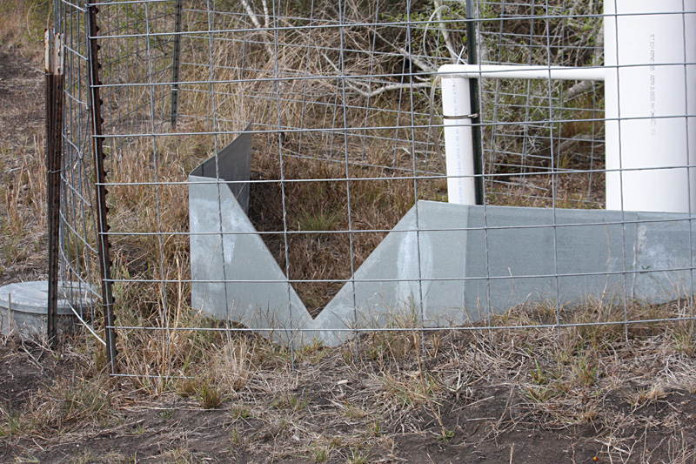
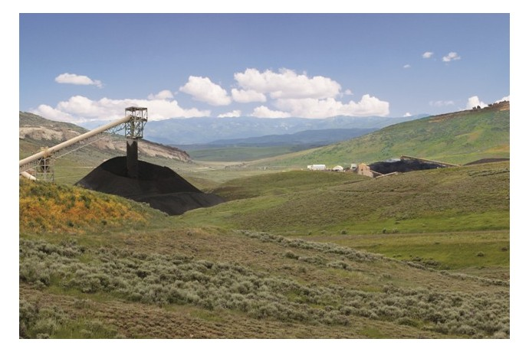
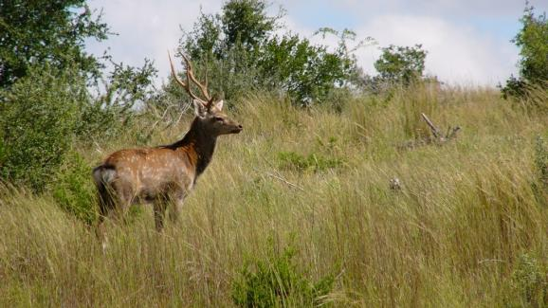
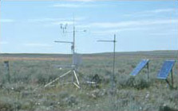

Slide 6
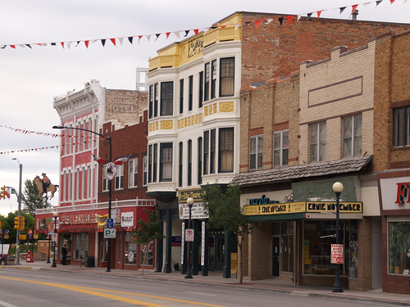
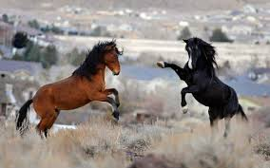
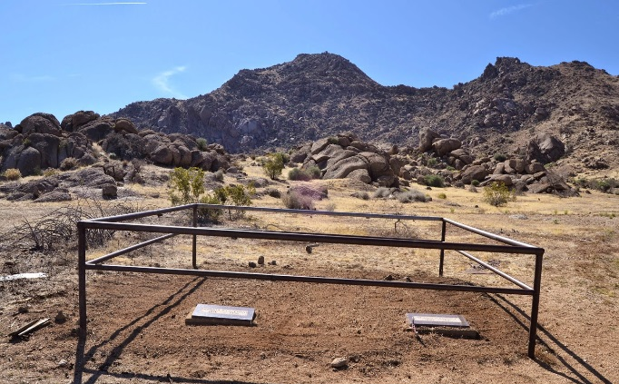

Slide 7
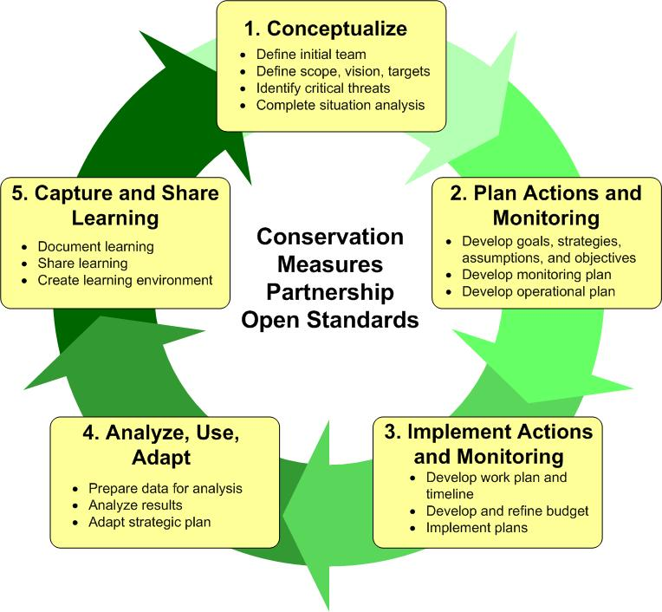
Adaptive management –
Structured iterative process of robust decision making
or
Framework promoting ‘superstitious learning’

Slide 8
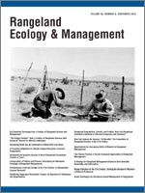
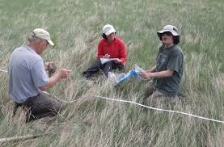

Slide 9
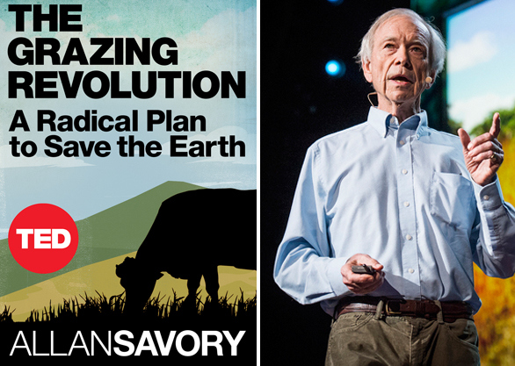
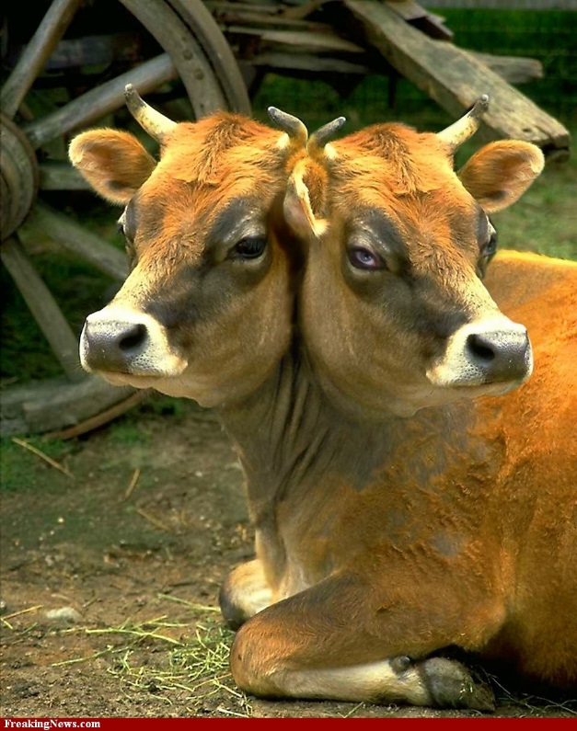
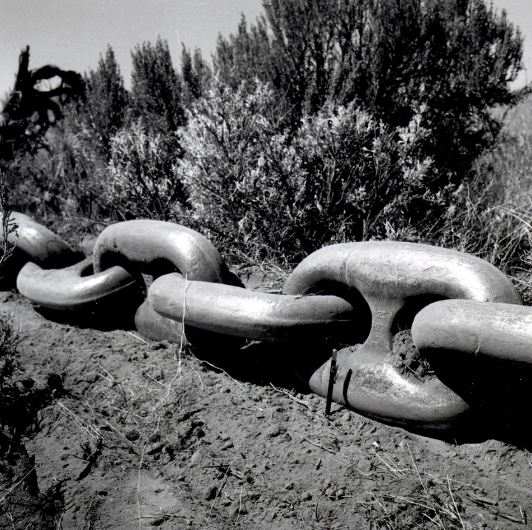
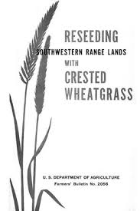
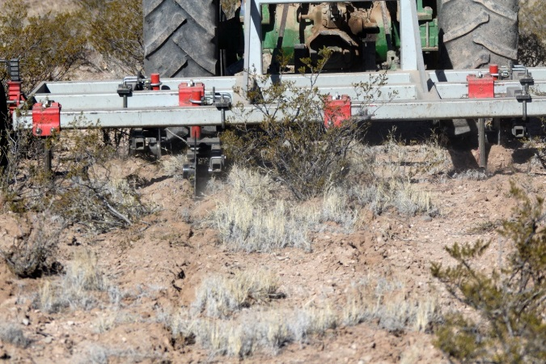

Slide 10
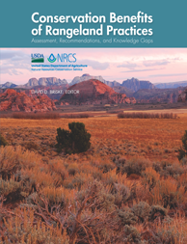

Slide 11
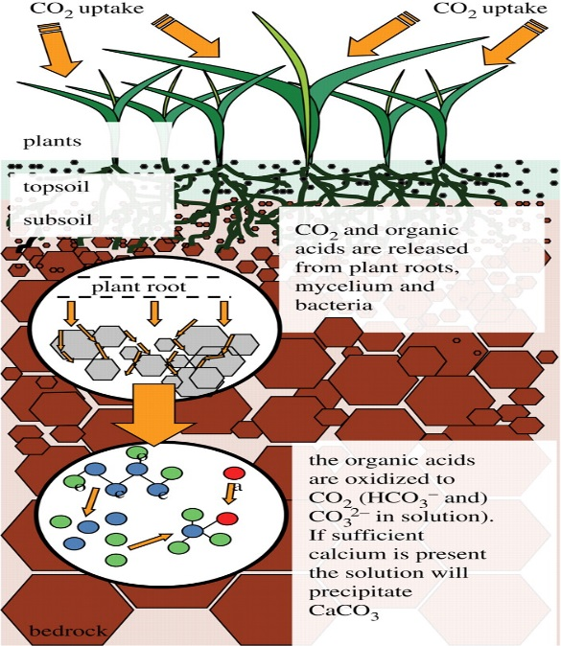
Soil carbon sequestration to offset atmospheric GHG levels
Seems like a really good idea!

Slide 12
Soil carbon sequestration to offset atmospheric GHG levels
Fairly complicated and complex

Slide 13
Soil carbon sequestration to offset atmospheric GHG levels
+ feedbacks

Slide 14
Soil carbon sequestration to offset atmospheric GHG levels
- feedbacks

Slide 15
Soil carbon sequestration to offset atmospheric GHG levels
Its all too hard!

Slide 16
Soil carbon sequestration to offset atmospheric GHG levels
Activity focused rather than outcome focused-half finished experiments

Slide 17
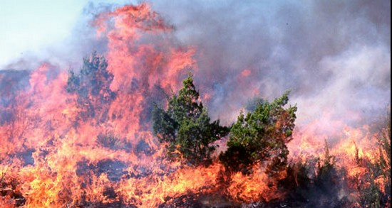
Dr David Bowman “Management by Hypothesis”
Landscape management practices must be defined and treated as experiments
experiments have hypotheses, design, analysis and testing
New Scientist 1995

Slide 18
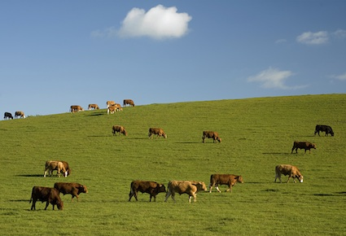
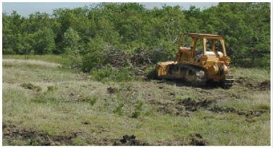
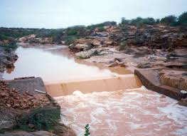
For science to be relevant, it has to be used
Using rigorous testing and hypotheses that can be rejected

Slide 19
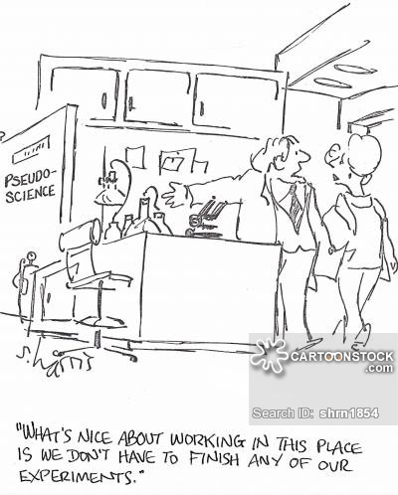

Slide 20
RANGELAND SUSTAINABILITY:
IS SCIENCE RELEVANT
yes
WHAT IS NEXT?
more time, effort and commitment to hypothesis development, testing and refinement

