Slide 1
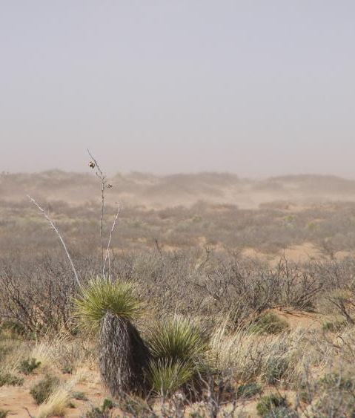
I’m … not … Jim Dobrowolski
My world Jim’s world

Slide 2
Future Directions of Usable Science for Sustainable Rangelands: Water
Jim Dobrowolski and Dave Engle
(presented by Jeff Herrick*)
Disclaimer: Jim only gave me 11 slides. So I improvised with the ones marked with a
*
Notes:
But today I get to dream about Jim’s world, and about how much fun he’s going to have in the future.

Slide 3
Water is essential to life and the sustainability of rangelands
Rangelands include a significant portion of the Nation's watersheds;
Clean water depends on the conservation and stewardship of rangelands
The water that ends up in rivers, lakes, and coastal waters downstream falls on these lands first;

Slide 4
*

Slide 5
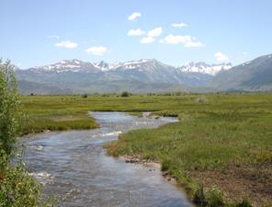
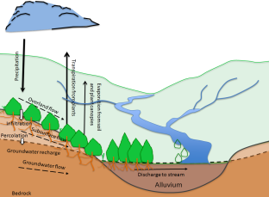
Water balance on (most US) rangelands
Potential evapotranspiration is much greater than precipitation, contributing to a large soil water deficit
Water balance factors are scale-dependent.

Slide 6
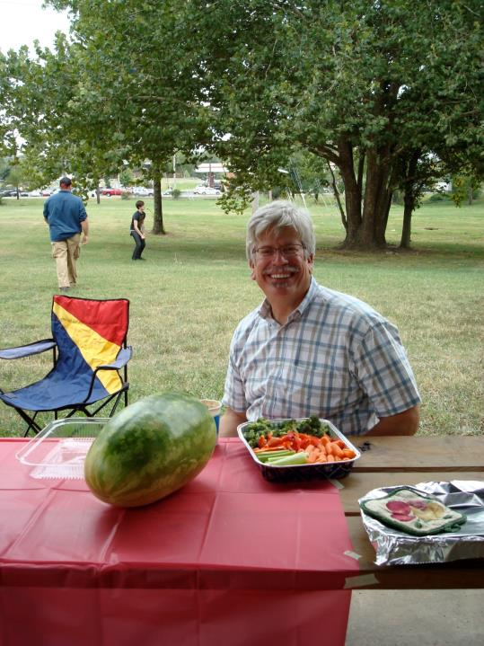
*
Notes:
So the next time you’re having a picnic with Jim, you can think about how the water balance at the scale of the grass plant, tree and park.

Slide 7
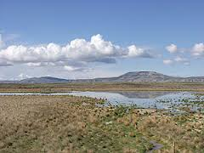
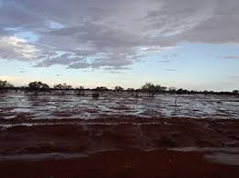
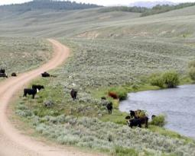
Rangeland water as a research focus
Ecosystem services, including water, will continue to face increasing pressure.
Landscape change could adversely affect the water balance and rangeland processes.
A rich suite of pressing research opportunities for usable science.

Slide 8
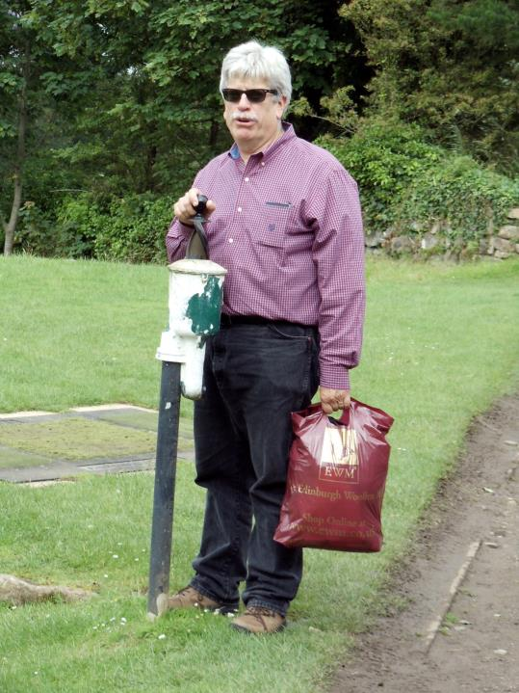
Notes:
Fortunately, since golfcourses use a lot of water relative to rangelands, we can do comparative studies.

Slide 9
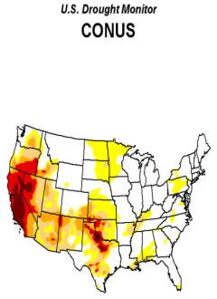
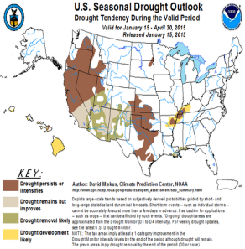
Water on rangelands research/extension priorities
Proactive tools for monitoring and predicting drought (#3, #4 and others in the overall ranking—Useable Science Workshop)

Slide 10
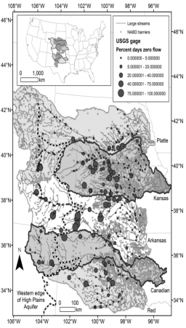
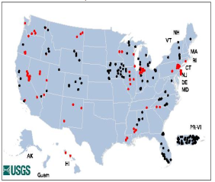
Water on rangelands research/extension priorities
Enhancing the nation’s stream gauges across basins that cross political boundaries
USGS Threatened and Endangered Stations
388 stations closed or threatened
http://streamstats09.cr.usgs.gov/ThreatenedGages/ThreatenedGages.html
Perkin et al. Ecological Monographs. Pre-print available online.

Slide 11
Notes:
Jim’s got the politics problem solved – he and his wife serve amazing cookies to USGS and even folks like me from ARS.

Slide 12
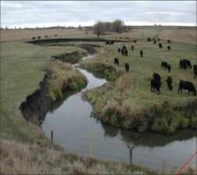
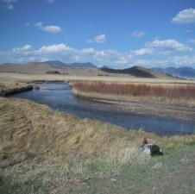
Water on rangelands research/extension priorities
Proactive watershed management and protection of high quality rangeland watersheds (overall rank #6)
policies aimed at preventing degradation rather than restoration

Slide 13
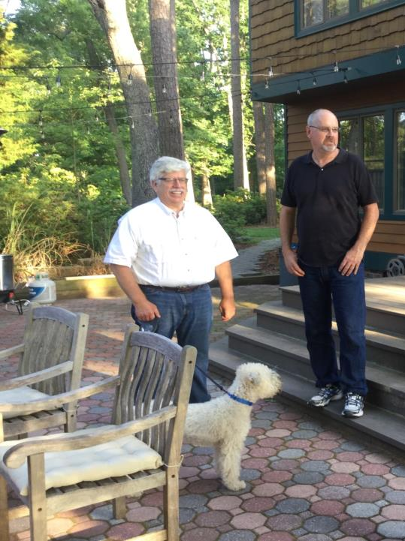
Notes:
And for enforcement, we have Jim’s dog and bodyguard.

Slide 14
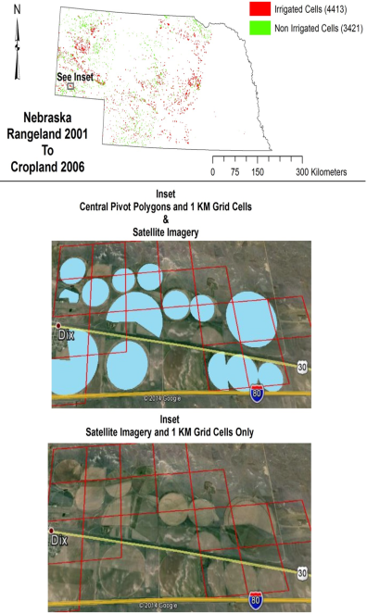
Water on rangelands research/extension priorities
Constructing water balances
better management decisions to respond to climate change,
drought, land use change

Slide 15
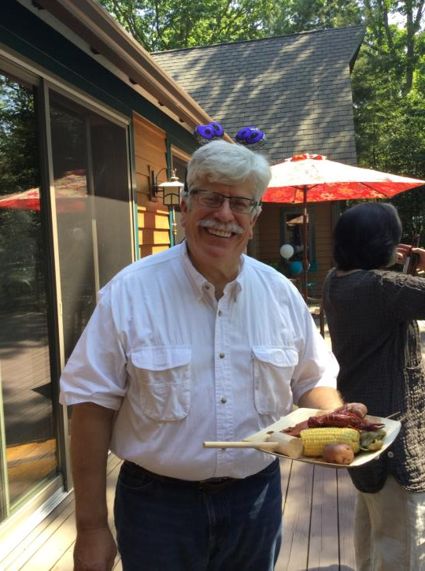
Notes:
That corn Jim’s about to eat while we sit in this session was grown on former rangeland, resulting in a dramatic change in hydrology.

Slide 16
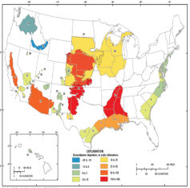
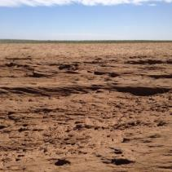
Water on rangelands research/extension priorities
Develop technologies to restore abandoned cropland back to rangeland, driven by aquifer depletion, drought, and climate change (overall rank #81)
Economic evaluation, particularly cost-benefit analysis, of rangeland restoration
Cumulative aquifer depletion, 1900-2008 (USGS 2013)
Wind erosion on cropland formerly irrigated. Photo courtesy of Gary McManus.

Slide 17
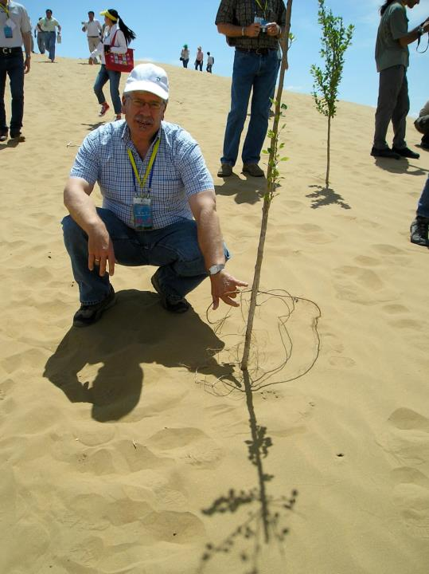
Notes:
So I think this is a tree.

Slide 18
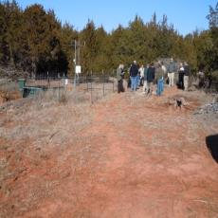
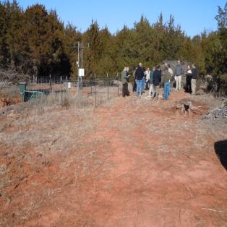
Water on rangelands research/extension priorities
Extending science and BMP’s to users through Extension is a fundamental bottleneck (#2 and #5 and others in the overall ranking)

Slide 19
Members of the Water Group
Tamzen Stringham, University of Nevada-Reno
Robert Potts, Dixon Water Foundation
Bill Sproul, Sproul Ranch, Kansas
Jim Dobrowolski, USDA-NIFA
Dave Engle, Oklahoma State University

Slide 20
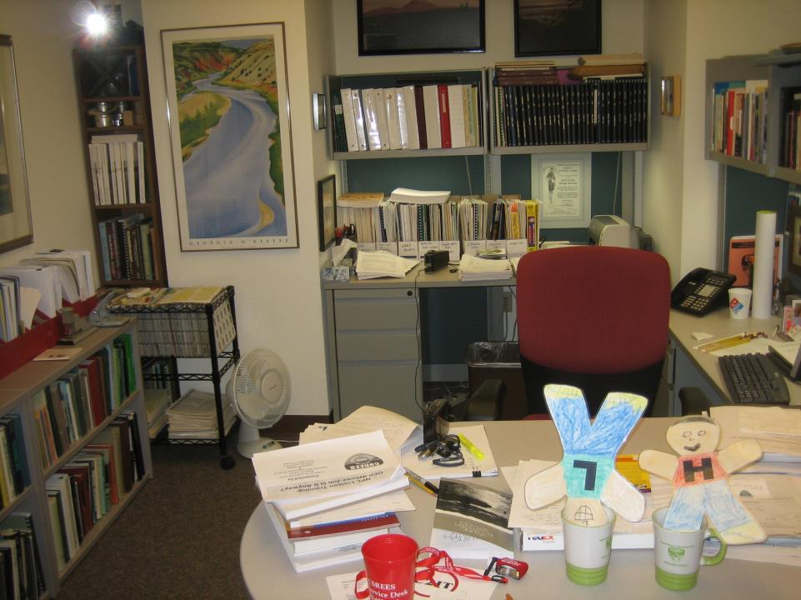
Notes:
Jim said he’d be available in is office for questions. At least he left us a nice painting of a river to look at.

