Slide 1
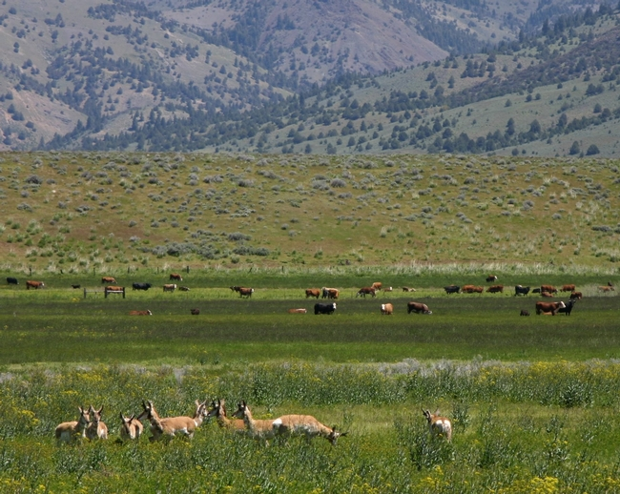
Co-creating a social-ecological research agenda for rangelands
Mark Brunson, Utah State University
Notes:
This entire Ignite session rests on a simple premise: If we want science to be usable, we need to know what users want to know. I’d argue that’s especially true for social-economic studies, because we’re talking about people’s lives and livelihoods.

Slide 2
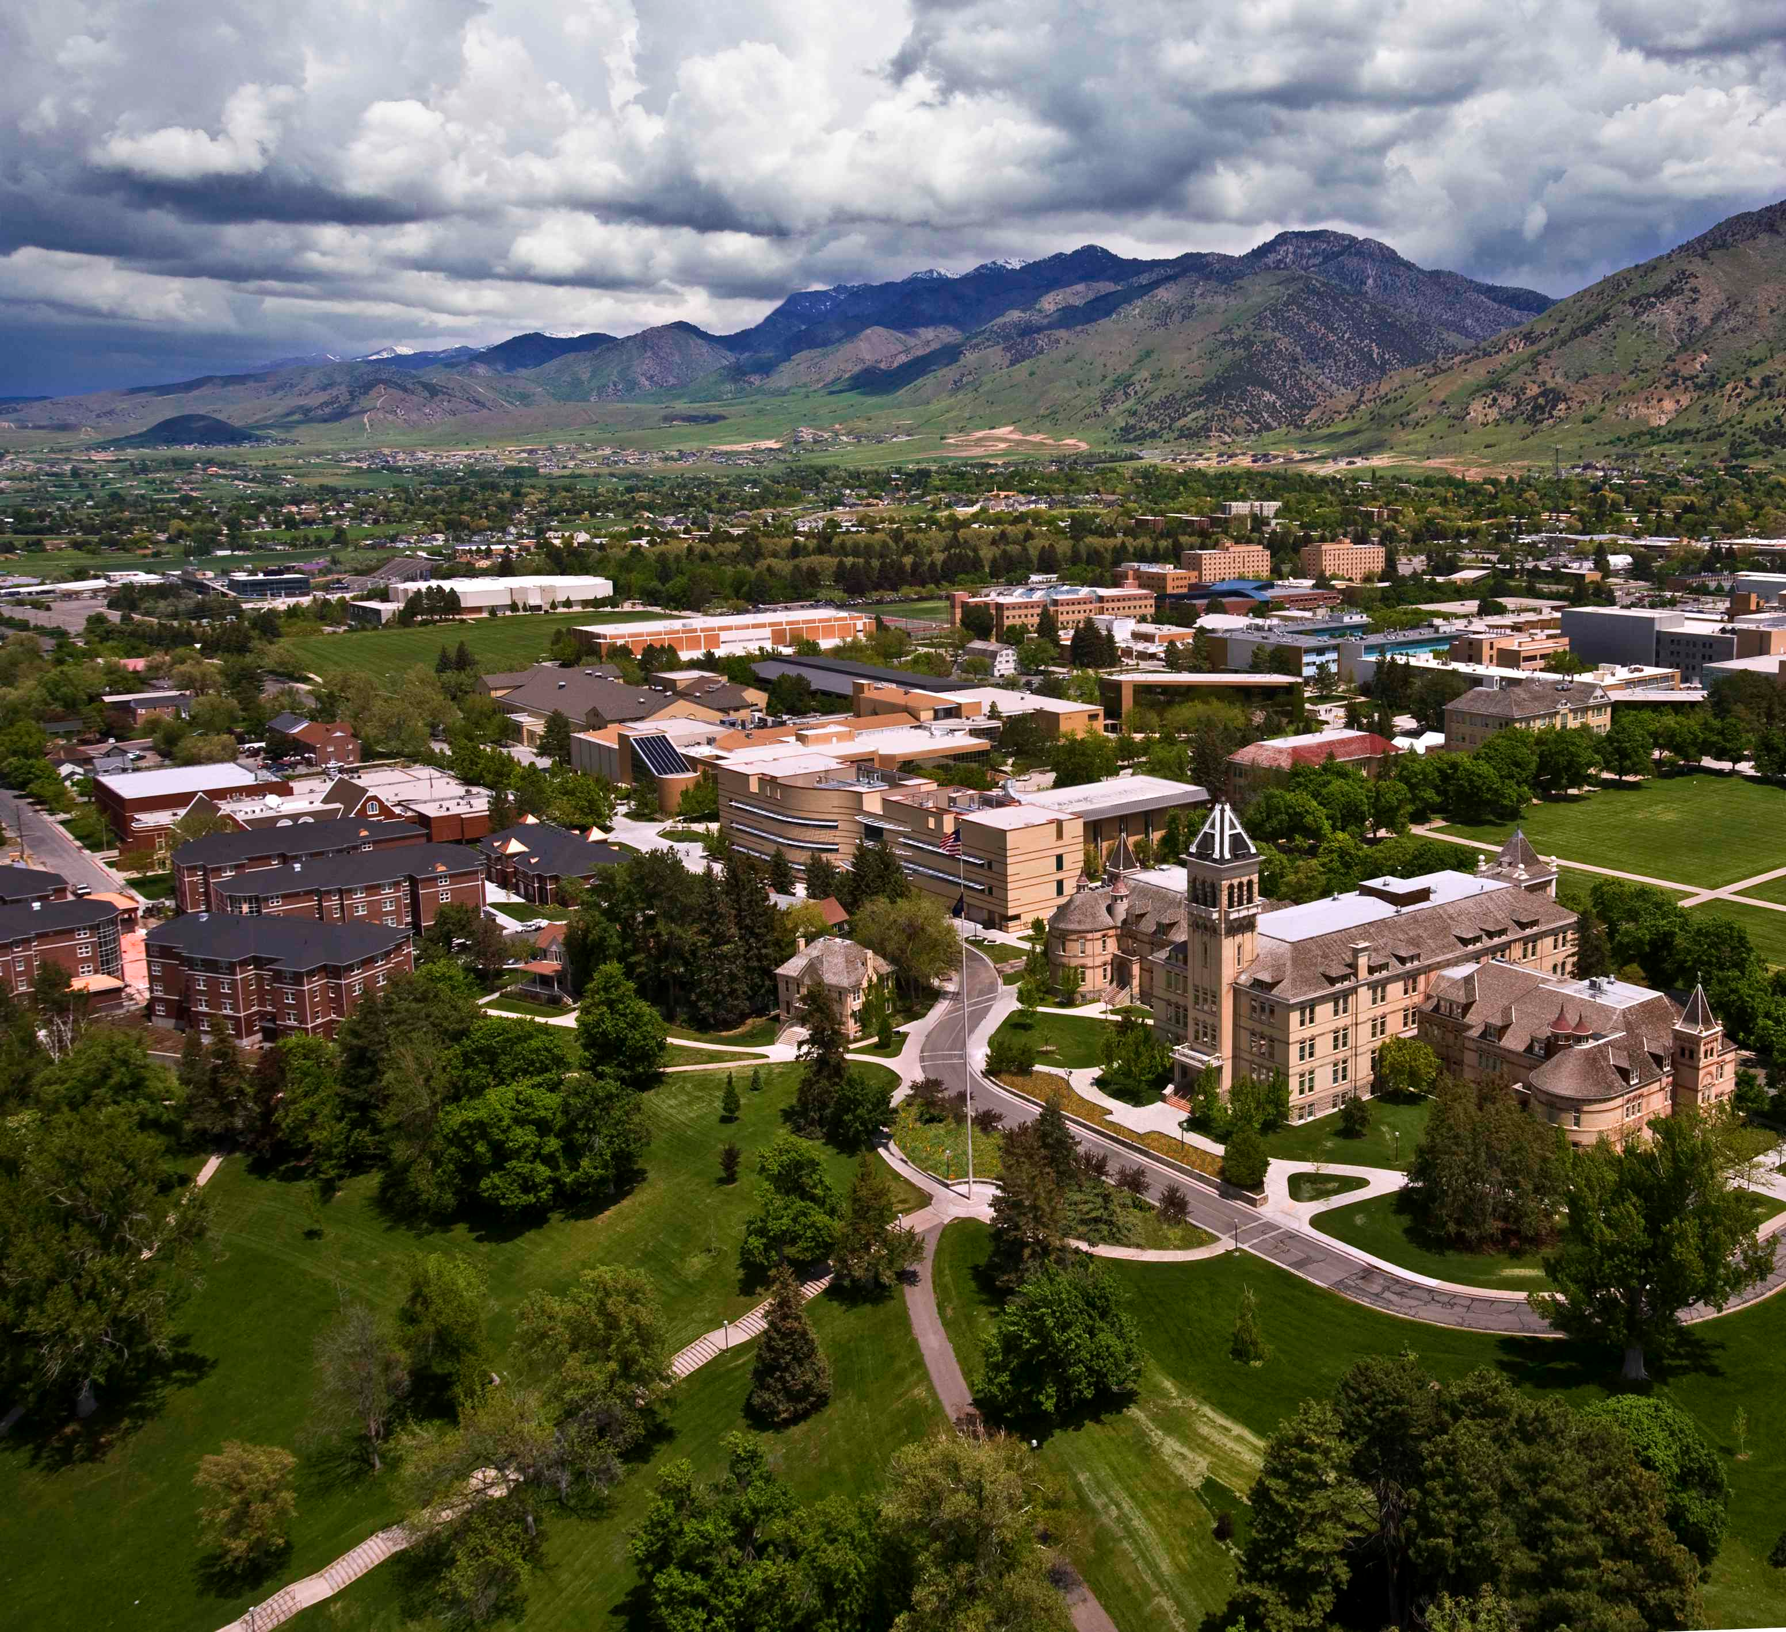
Notes:
At Land Grant Universities like mine, applied science is emphasized. But even here, our science often asks questions that we scientists want answers to, then assumes others will want the answers, too.

Slide 3
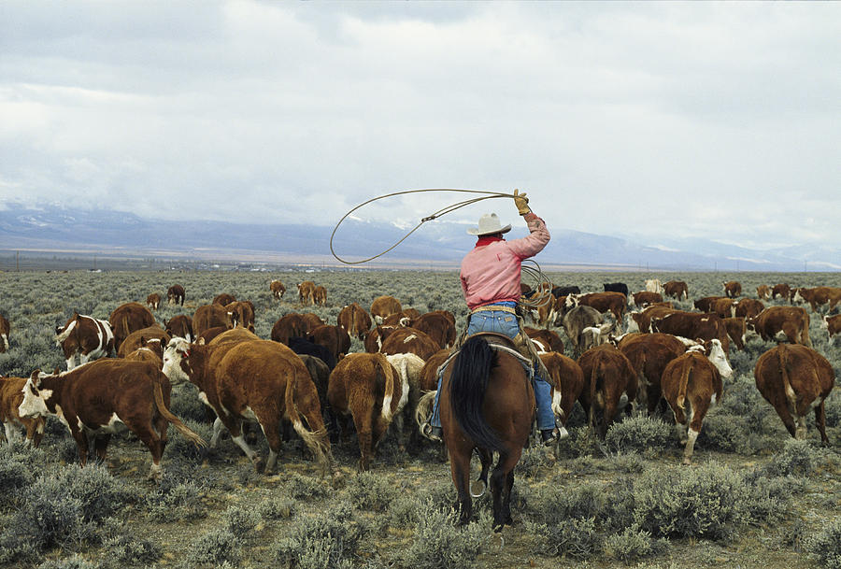
Notes:
You’ve already heard about several attempts to get past that barrier. When we turn to doing this for the social and economic sciences, we add a layer of complexity. We need also to ask ourselves the question: Which users’ needs are we trying to meet?

Slide 4
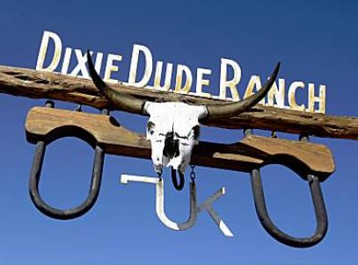
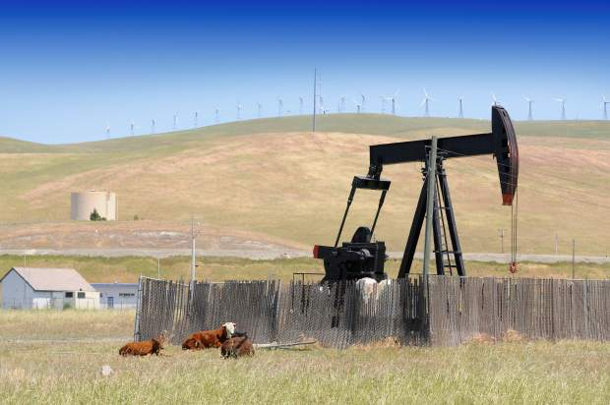
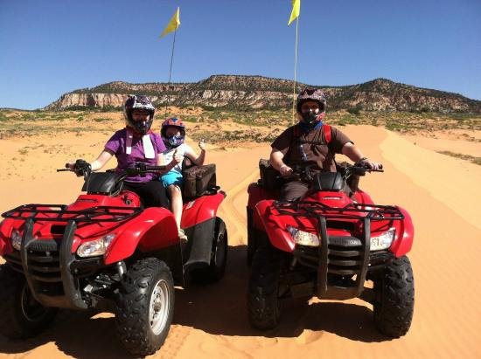
Notes:
Ranching is rangeland use that may come first into people’s minds. But there are numerous others, including recreation and tourism, energy development, and residential development. We need to understand the science needs of all these users.

Slide 5
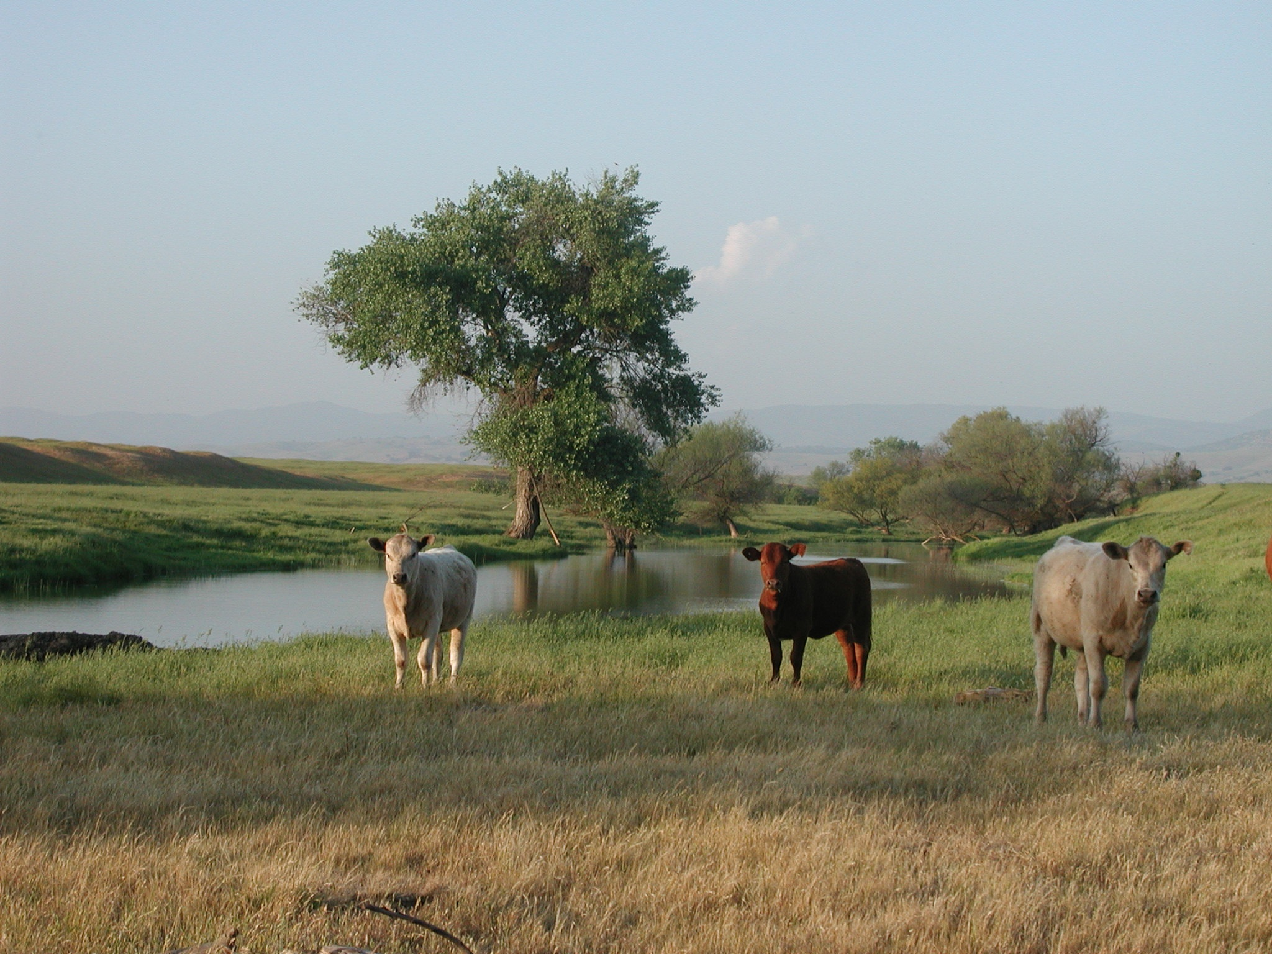
Notes:
Any ecosystem that’s managed to sustain both products from nature and services for people is a social-ecological system. So when we set out to craft a socio-economic research agenda, we really created a social-ecological systems agenda.

Slide 6
ECOLOGICAL SUB-SYSTEM
SOCIAL SUB-SYSTEM
Coarse-scale environmental influences (e.g., climate, bioregion)
Coarse-scale societal influences (e.g., politics, agency culture, budgets)
CONTEXT
Stewardship choice
Ecosystem pattern & process
MANAGING FOR RESILIENCE
Desired use or condition
VARIABILITY
Local environmental conditions
Local beliefs & behaviors
Notes:
The term ”social-ecological systems” may make us think of mind-numbing diagrams like this one. But you don’t have to model a system to recognize that the well-being of people also depend on the health of ecosystems.

Slide 7
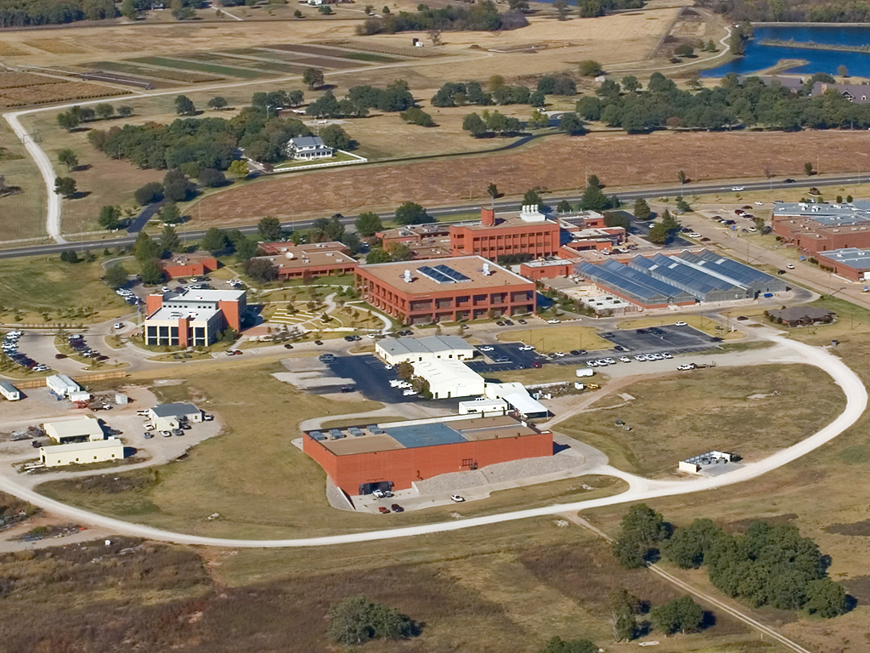
Notes:
The socio-economics group that met at the Noble Foundation included a rancher, an employee of an agriculture-focused NGO, an agricultural economist, and three people who study human dimensions of rangeland ecology and management.

Slide 8
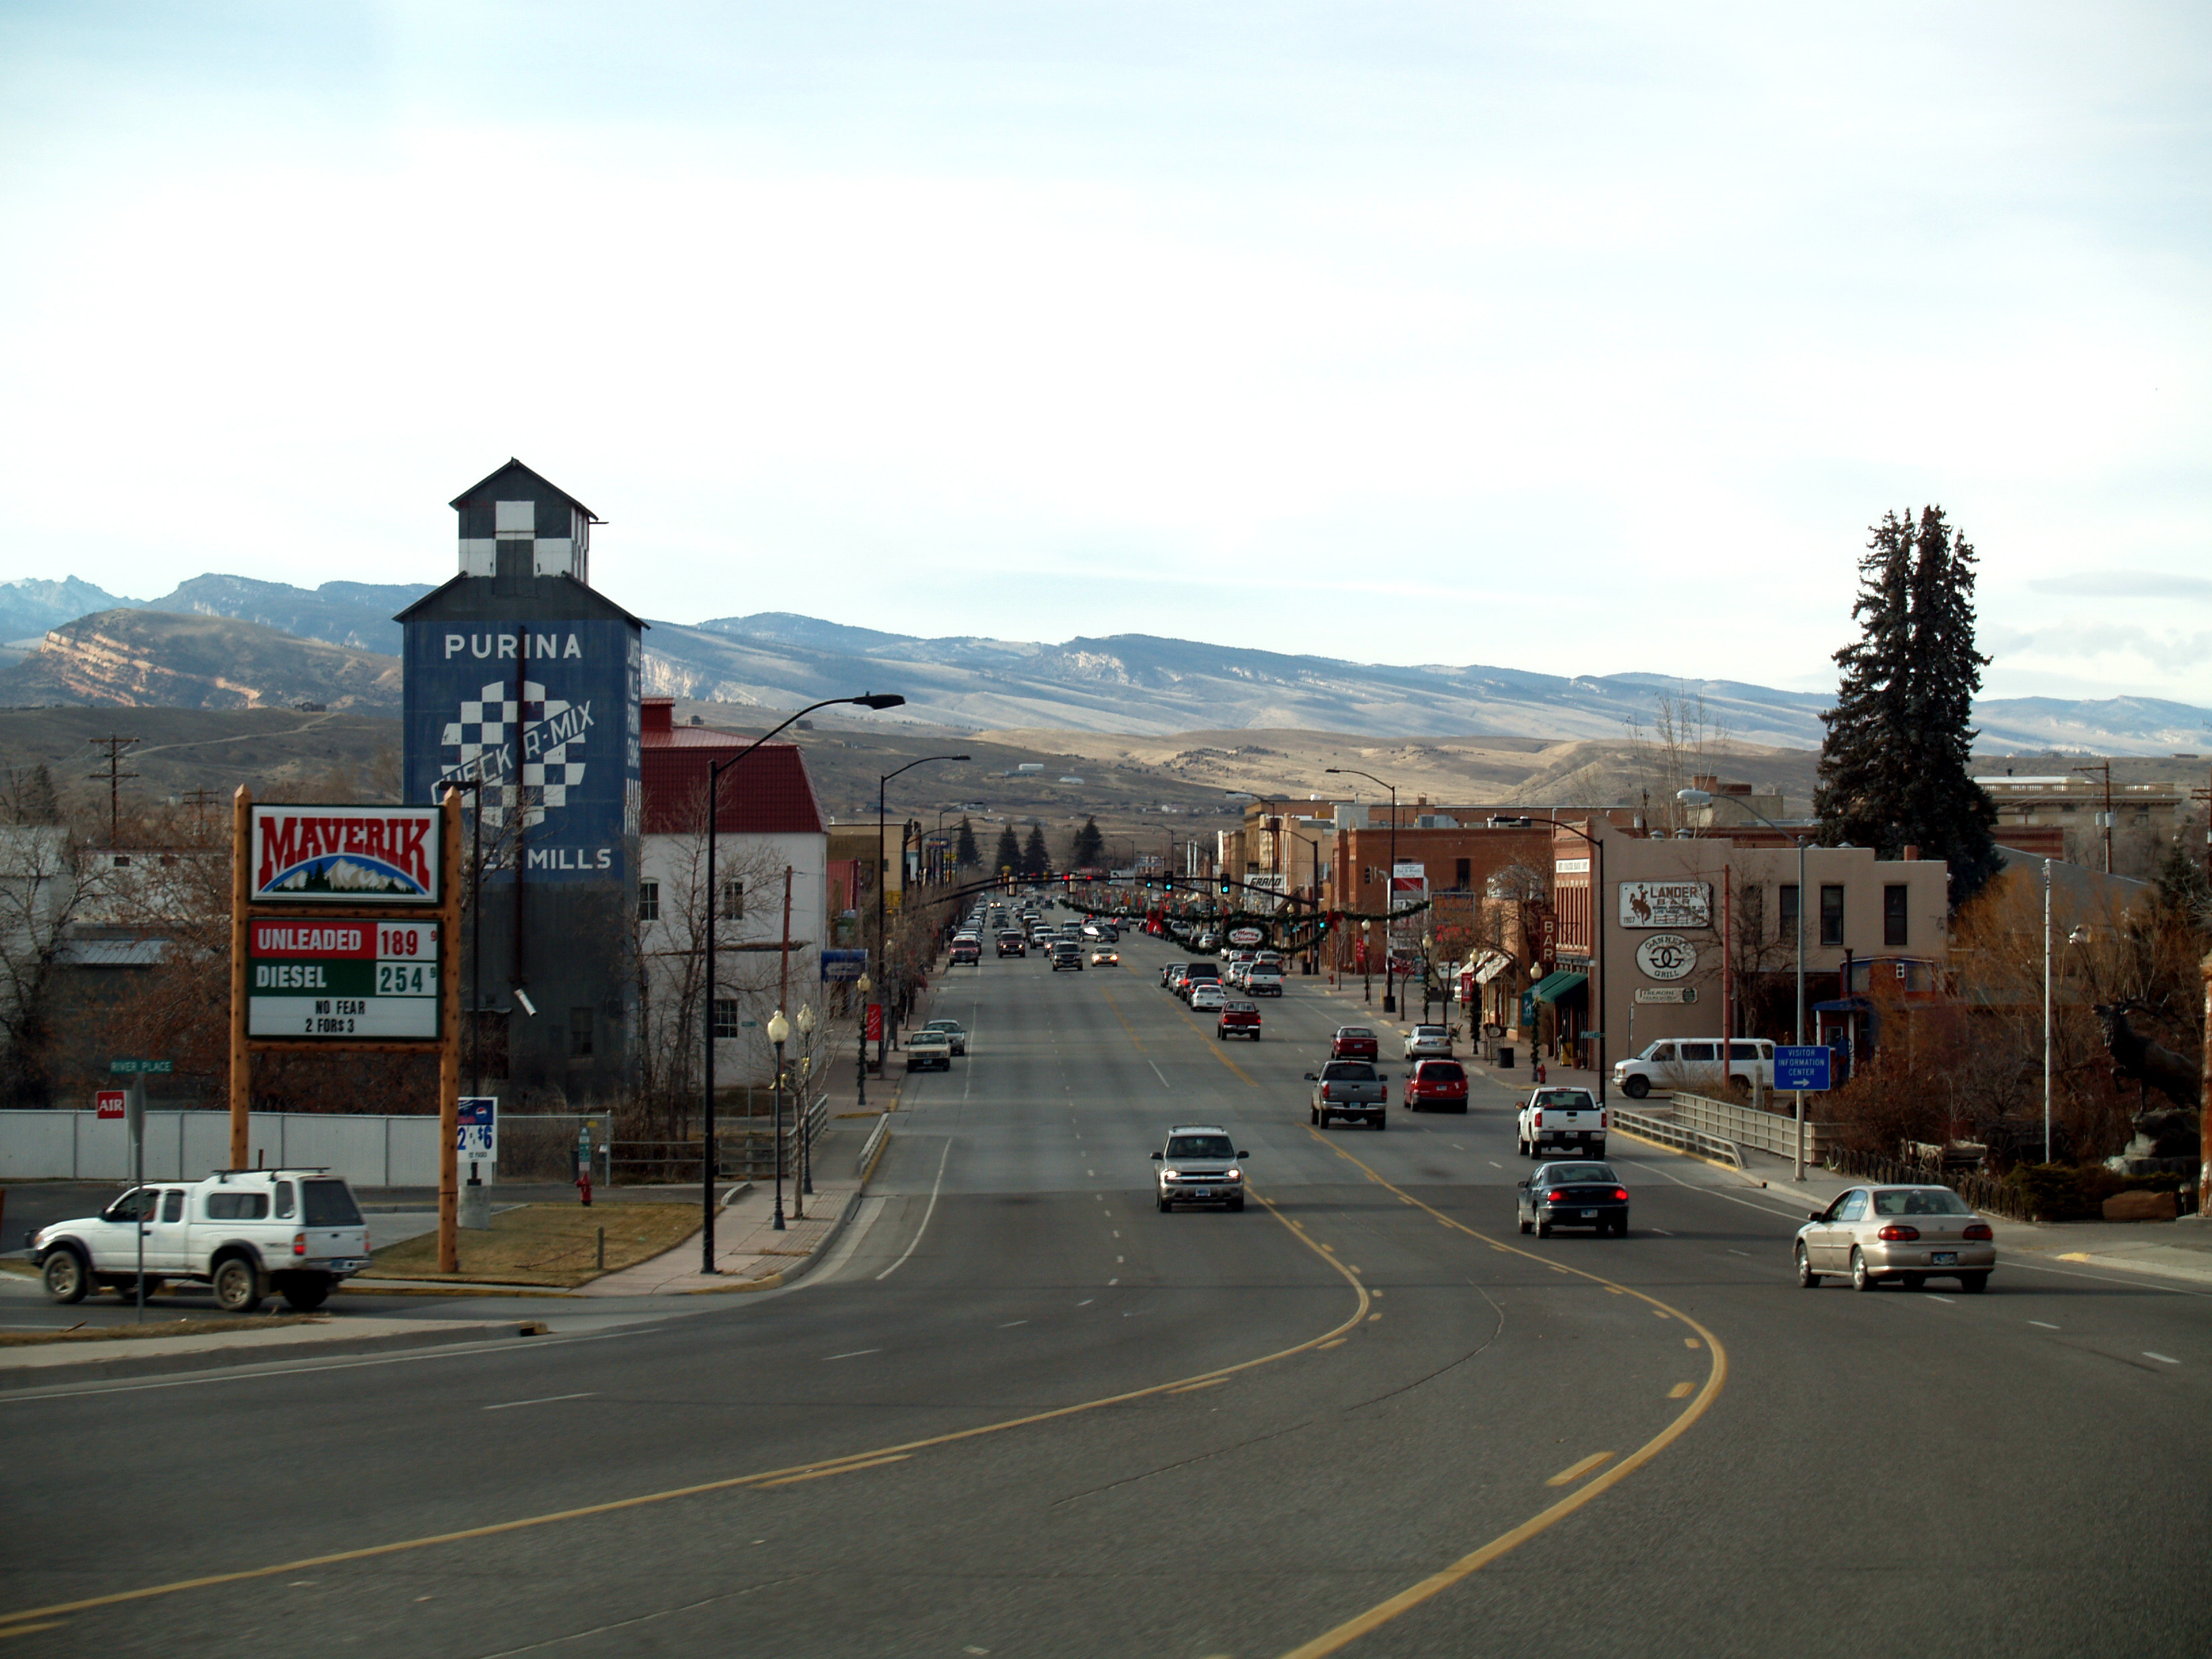
Notes:
We devised a very broad agenda – each “question” big enough to make a decent career – but each question focused on maintaining the health of rural communities where livestock production is a major economic force.

Slide 9
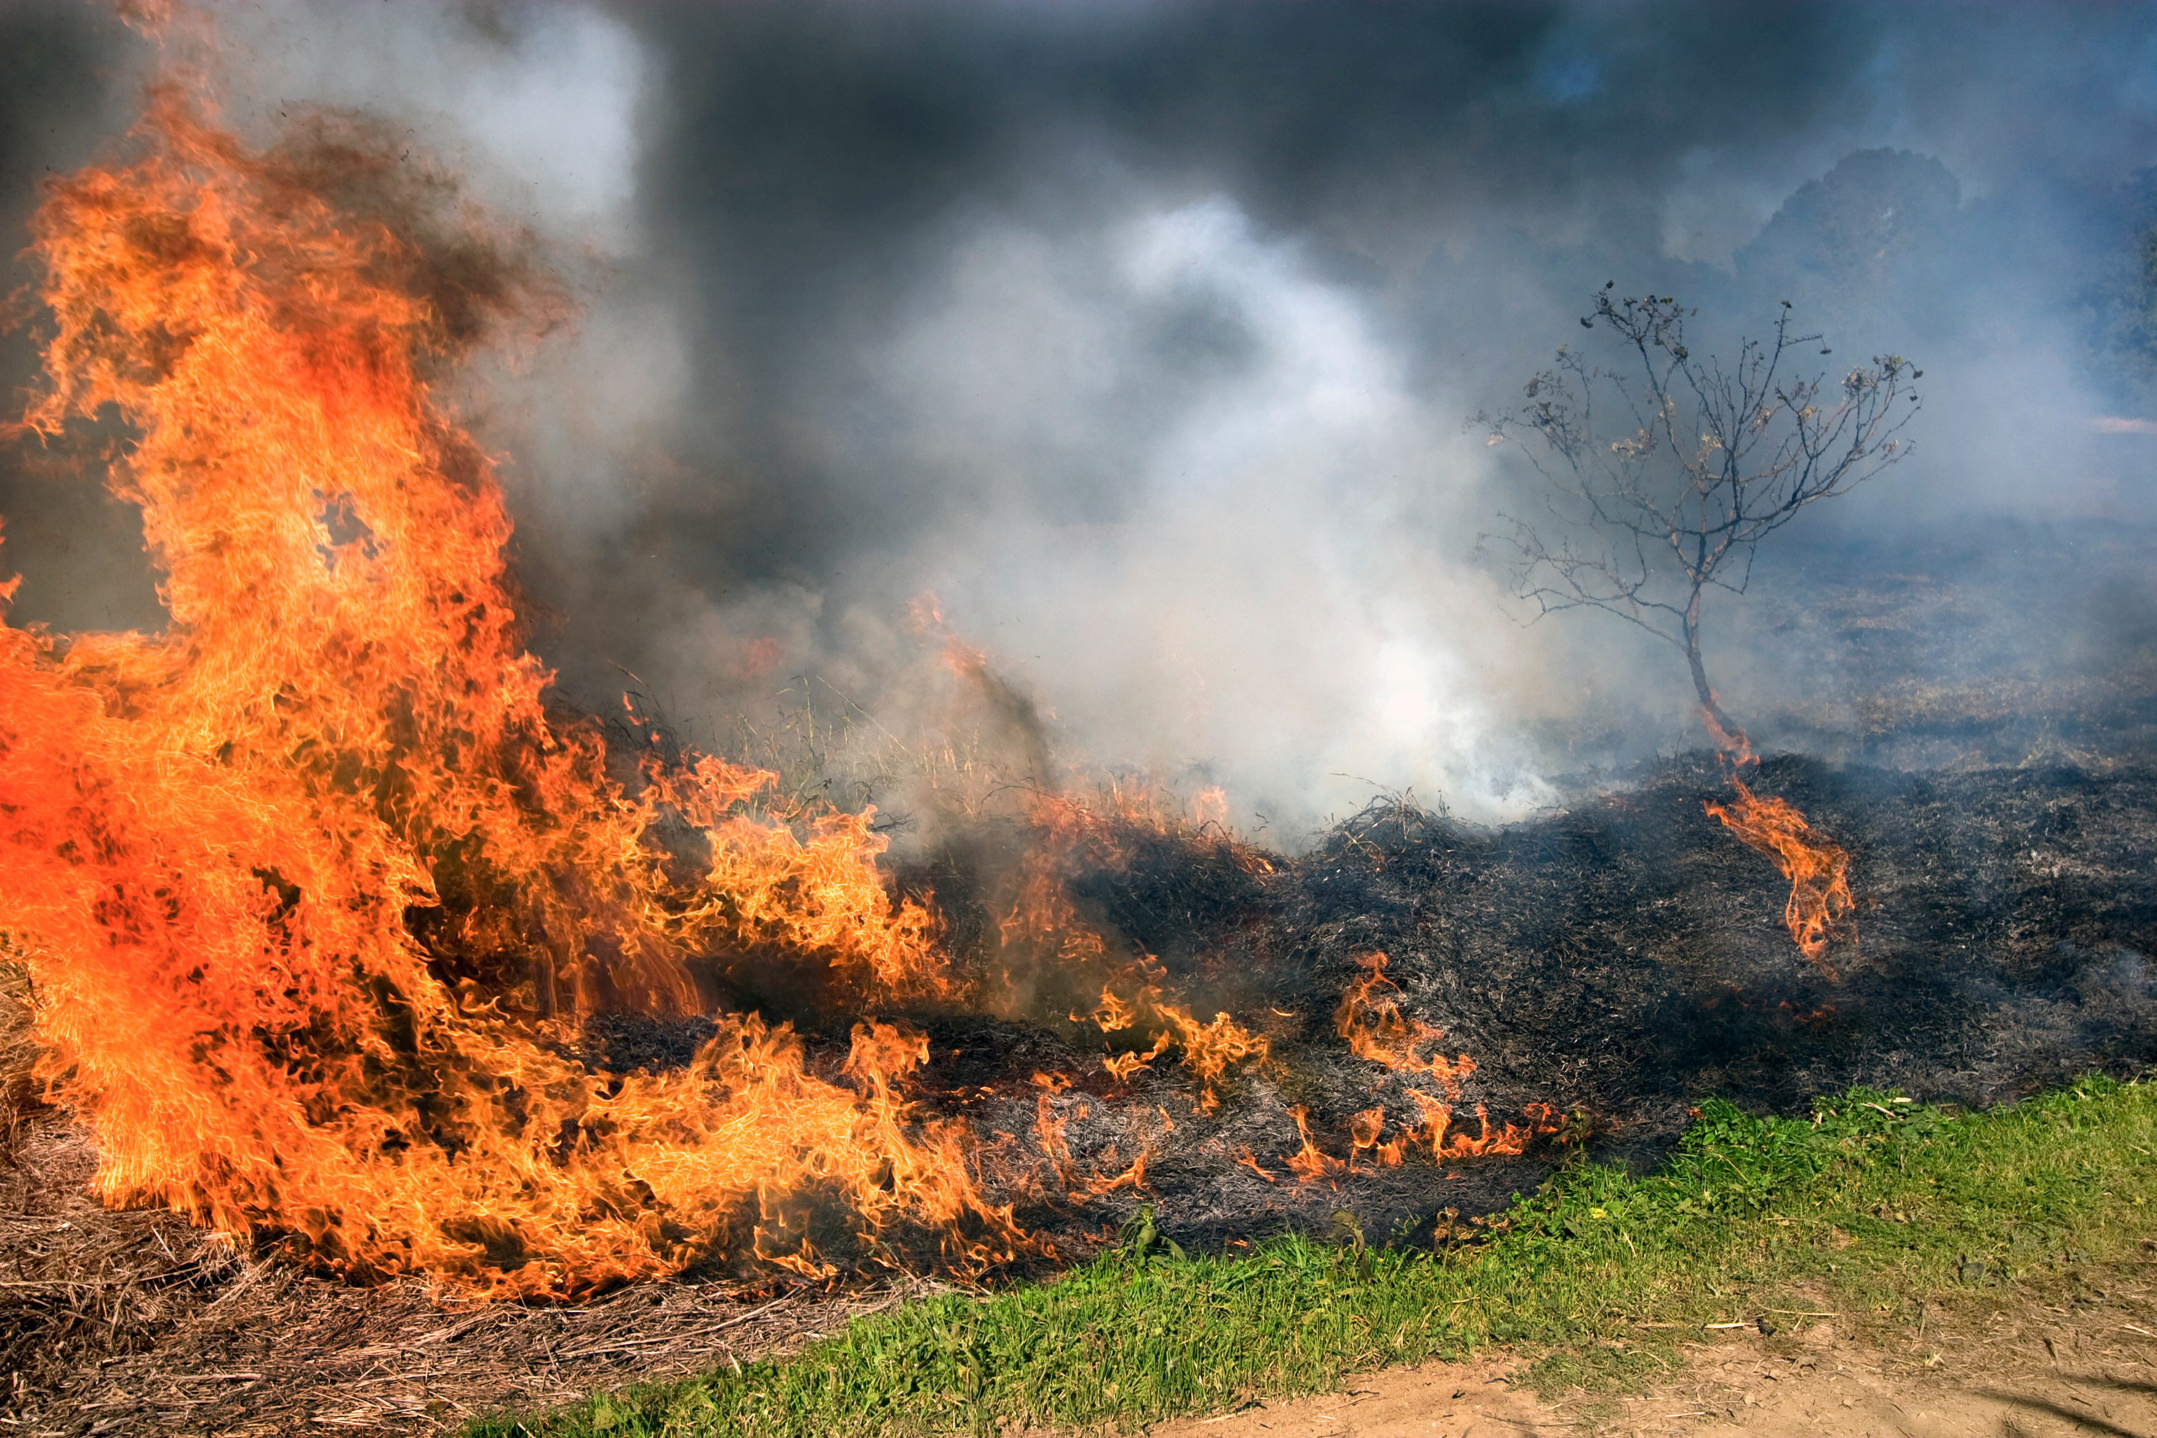
#1 issue overall:
Managing for variability (climate, drought, fire), adaptation & recovery
Notes:
The #1 issue for the whole workshop was about improving our capacity to deal with unprecedented environmental variability. It happened to be suggested by the socio-economic group. But it’s clearly a social-ecological question, with implications for natural systems as well as human ones.

Slide 10
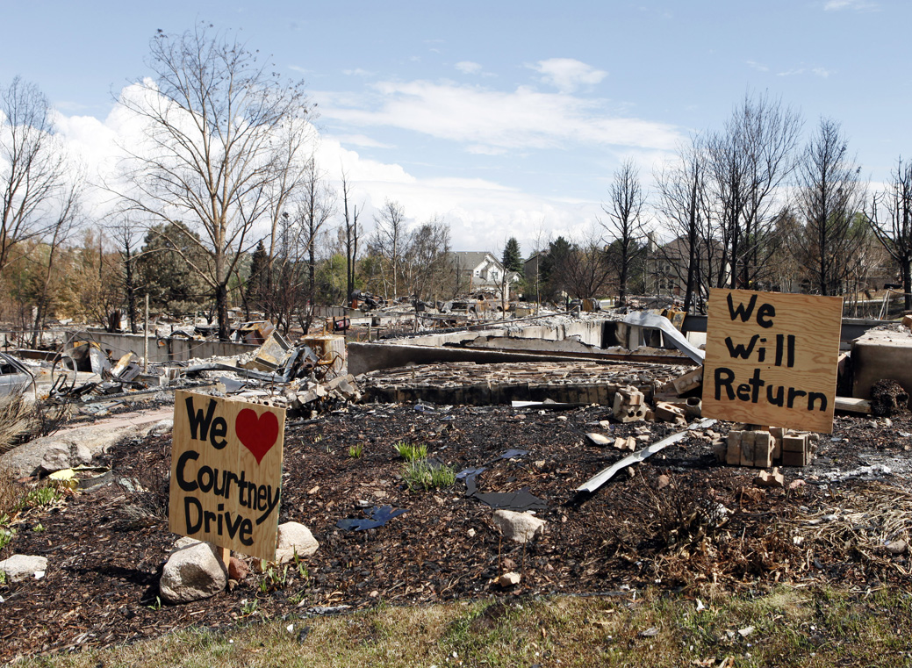
How do rural communities best prepare for, adapt to, and/or recover from impacts of environmental and socio-economic variability?
Notes:
To put it into a socio-economic context, the question focuses on needs of rural communities like this one in Colorado. How do they cope with change after a disastrous wildfire? What about coping with other types of change?

Slide 11
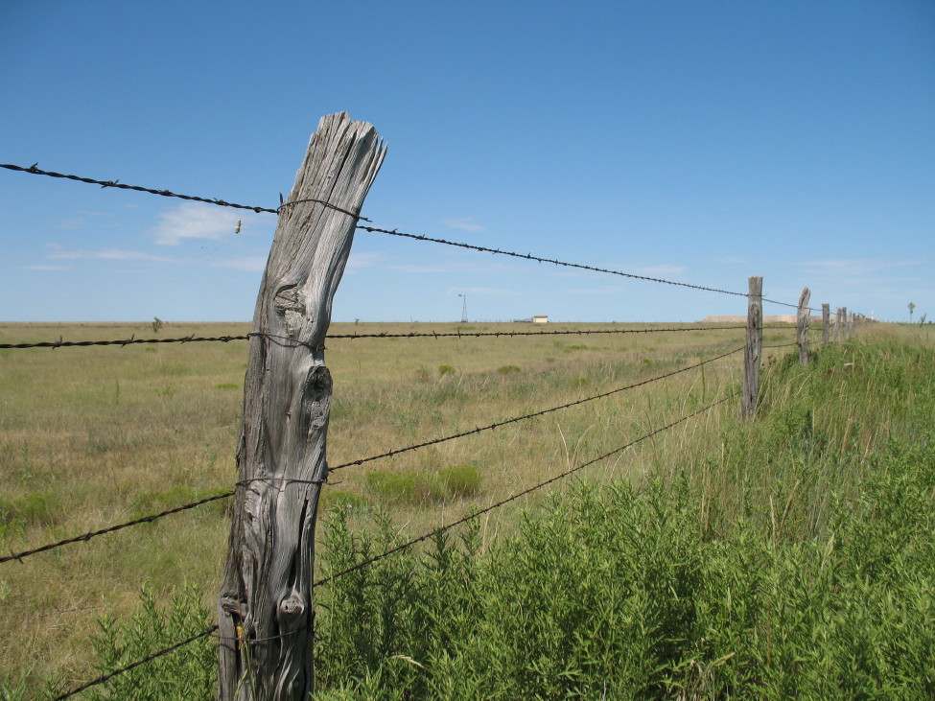
What motivates landowners to cooperate across boundaries for environmental stewardship?
Notes:
Another issue that rose to the top, with clear ecological implications, is about cross-boundary stewardship: What motivates landowners to cooperate across ownership or jurisdictional boundaries to sustain environmental quality?

Slide 12
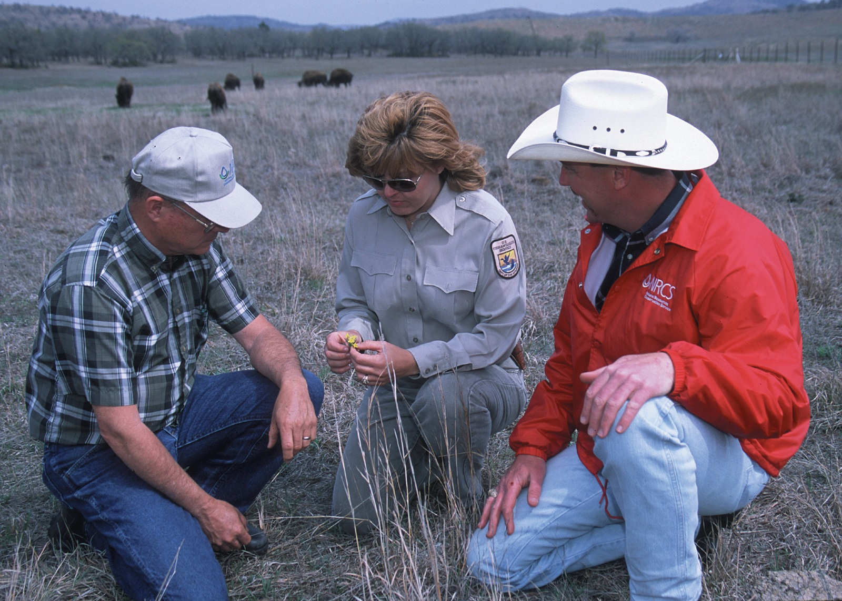
Notes:
We know the need to collaborate across properties, and between public and private landowners, will grow as rangeland ownership is more fragmented. Knowing why people do or don’t collaborate could enhance collaborative efforts.

Slide 13
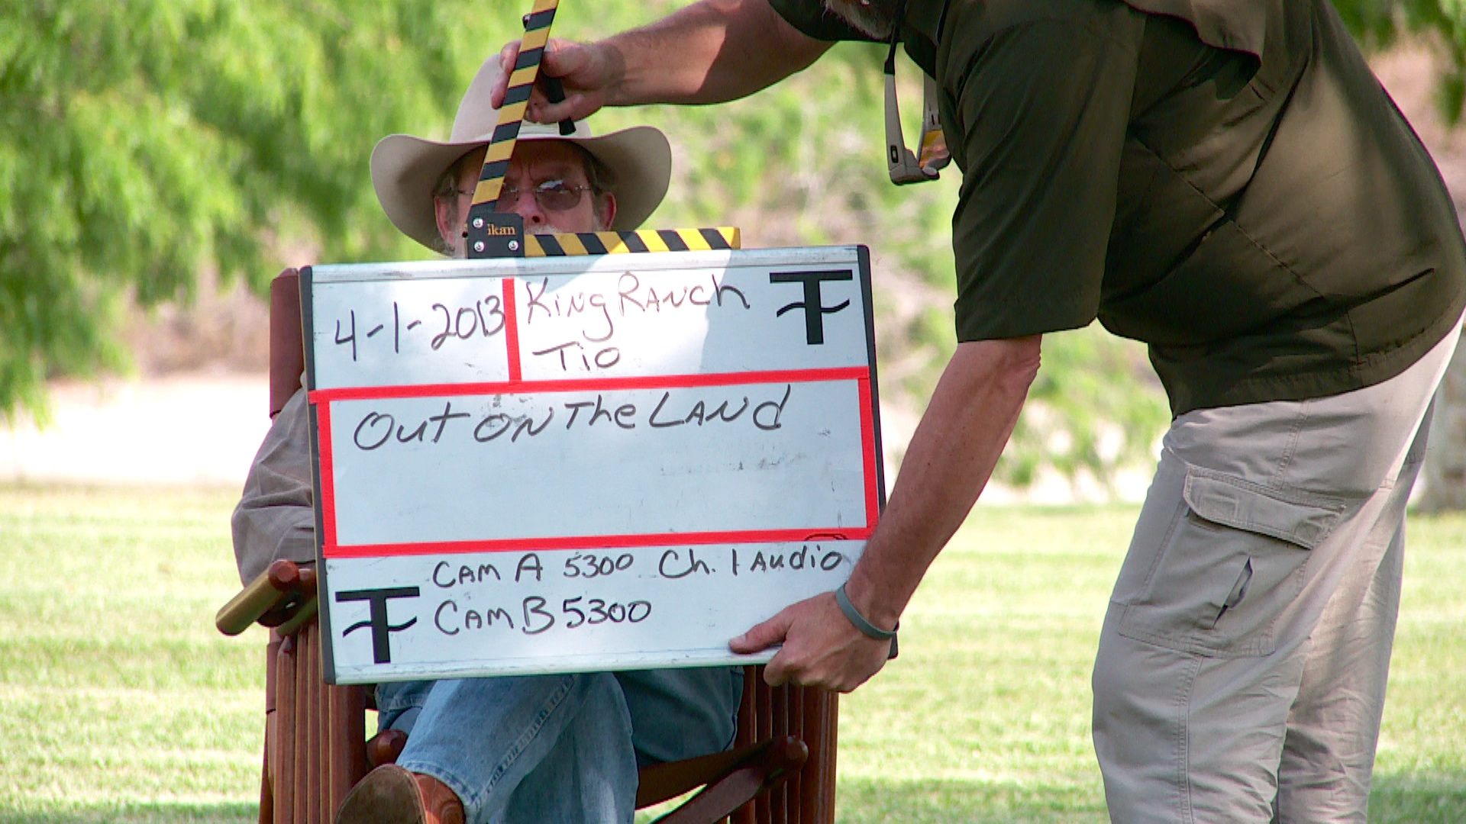
What information do different audiences need?
What influences whether & how they get it?
Notes:
Another highly ranked issue was about information transmission. Our stakeholders worried whether audiences know how to find the information to make sound decisions for rangelands, when it might best be found on small cable channels outside primetime.

Slide 14
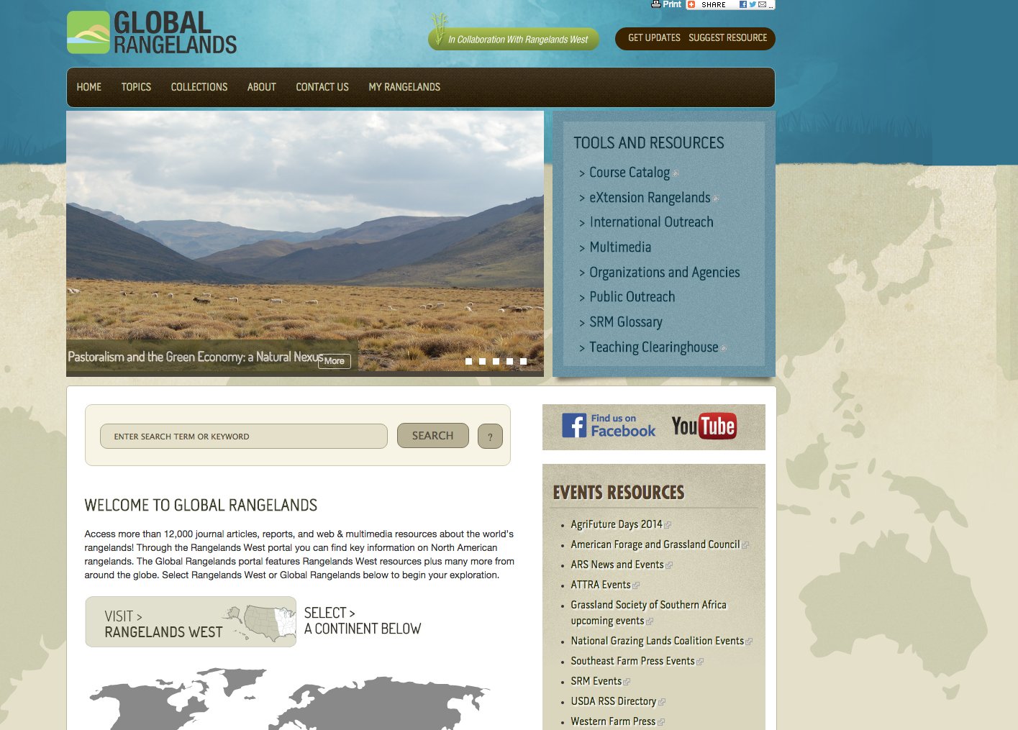
Notes:
A related issue has to do with quality of information. The reliability of online media is variable. For every website produced by scientists, like this one, there’s another that couldn’t stand up to peer review. Our workshop participants want to learn how to enhance the most reliable sources.

Slide 15
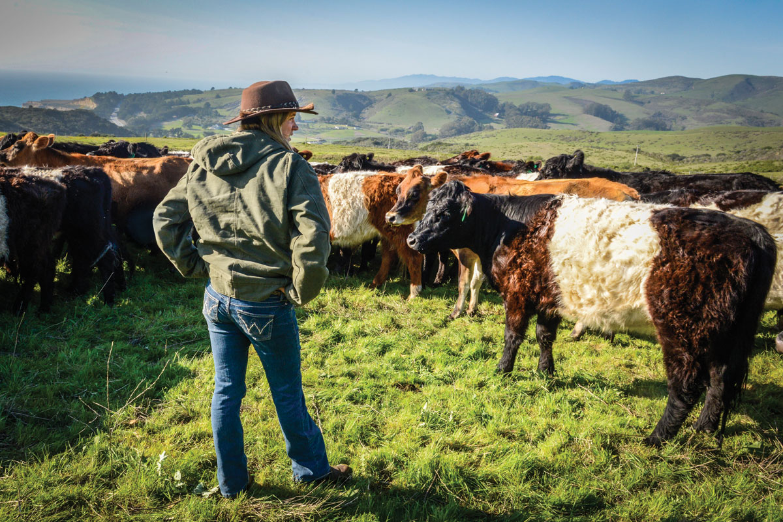
What prevents or helps people enter into rangeland occupations?
Notes:
The fourth most critical issue was keeping people on the land. Stakeholders want to learn more about barriers to entry into ranching and other rangeland occupations, and how to use that information to break down those barriers.

Slide 16
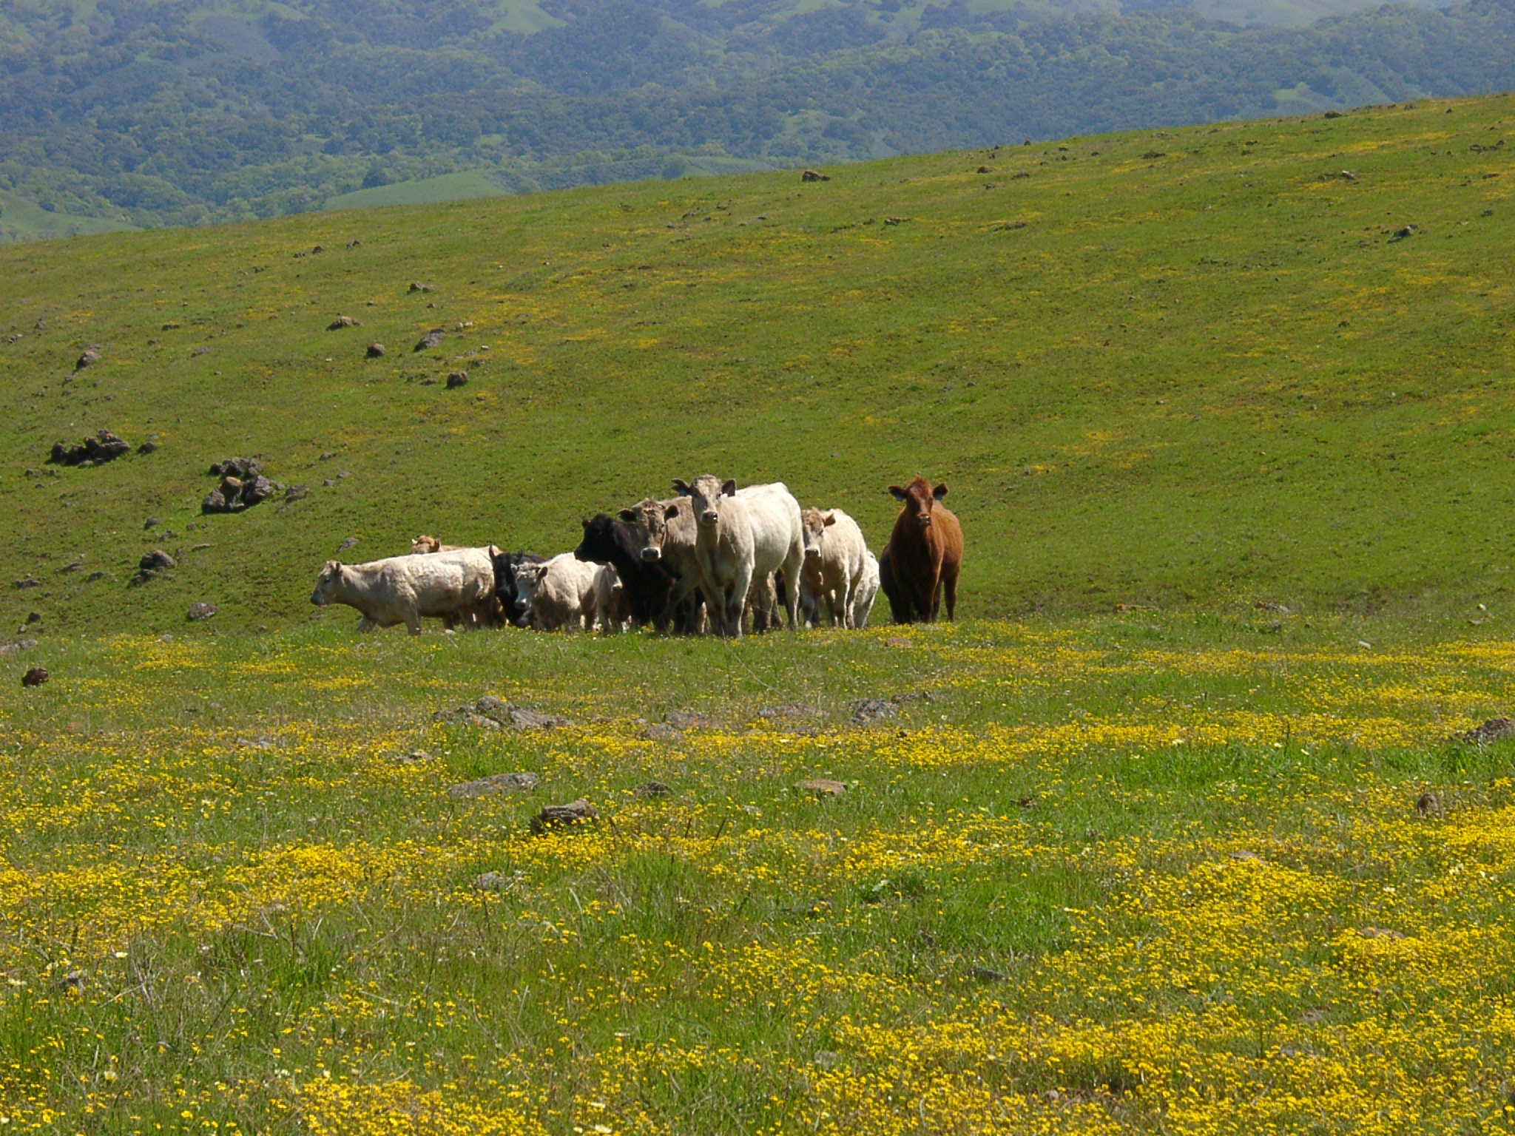
Notes:
This isn’t just self-interest. For example, cattle grazing supports native forbs that provide habitat for the threatened Bay Checkerspot butterfly. So what happens if ranchers can no longer afford to ranch in this part of California?

Slide 17
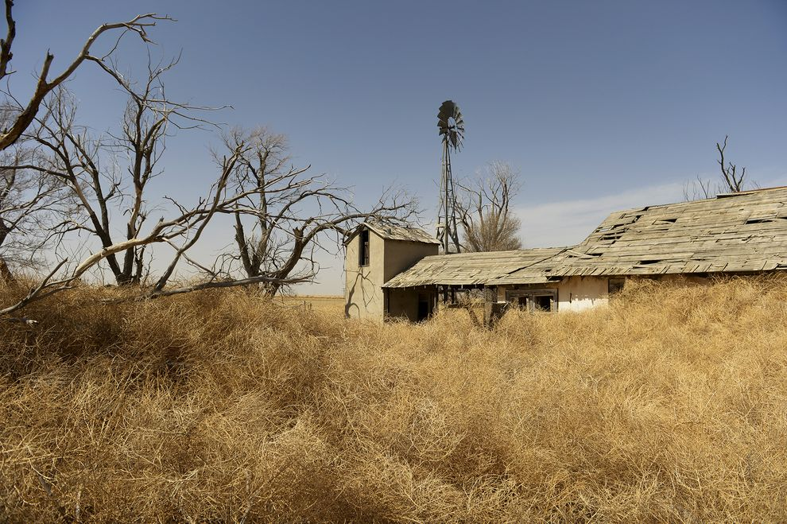
Notes:
Certainly removing livestock from the land can lead to better ecological outcomes, but it doesn’t always. The workshop participants helped alert me to the very real threat of rangeland degradation due to farm and ranch abandonment on the Great Plains.

Slide 18
Notes:
I administer several outreach programs designed to make science more accessible to end-users. The workshop has helped me think about how we might better share and target information across the spectrum of outreach entities to make science more accessible.

Slide 19
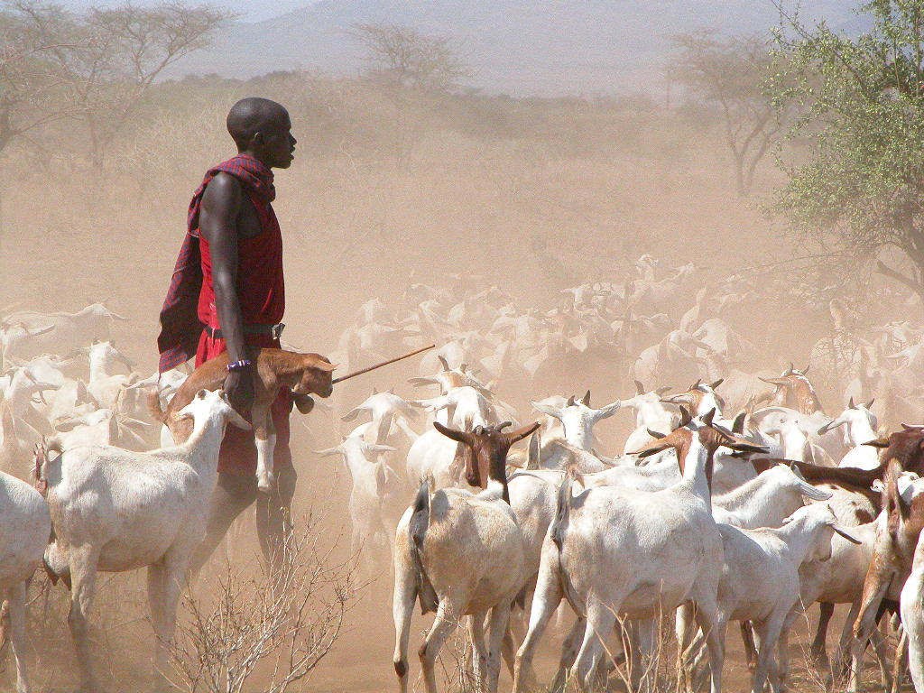
Notes:
In this talk I’m reporting on the outcome of one group of scientists and stakeholders in one part of the country. It’s important that we try to replicate this experience in other parts of the U.S. and beyond our borders, with a wider range of stakeholders.

Slide 20
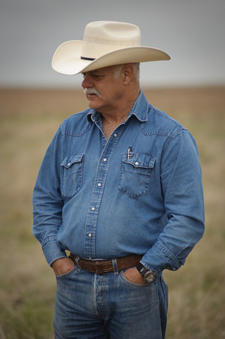
“Ranchers look at everything. Researchers look at specifics.”
- Rooter Brite, rancher Montague County, TX
Notes:
From my own perspective, it was valuable just to hear how non-scientists perceive what I do. This rancher told us scientists we think too narrowly to be as useful as we could be. My question s this afternoon is: How can we do a better job of connecting our specifics to the wider view that matters to rangeland science users? Thank you.

