Slide 1
Notes:
Thank you for having me on this panel, I will be discussing usable animal science for sustainable rangelands – but I also wanted to take a few minutes to discuss what sustainability means to the beef industry.

Slide 2
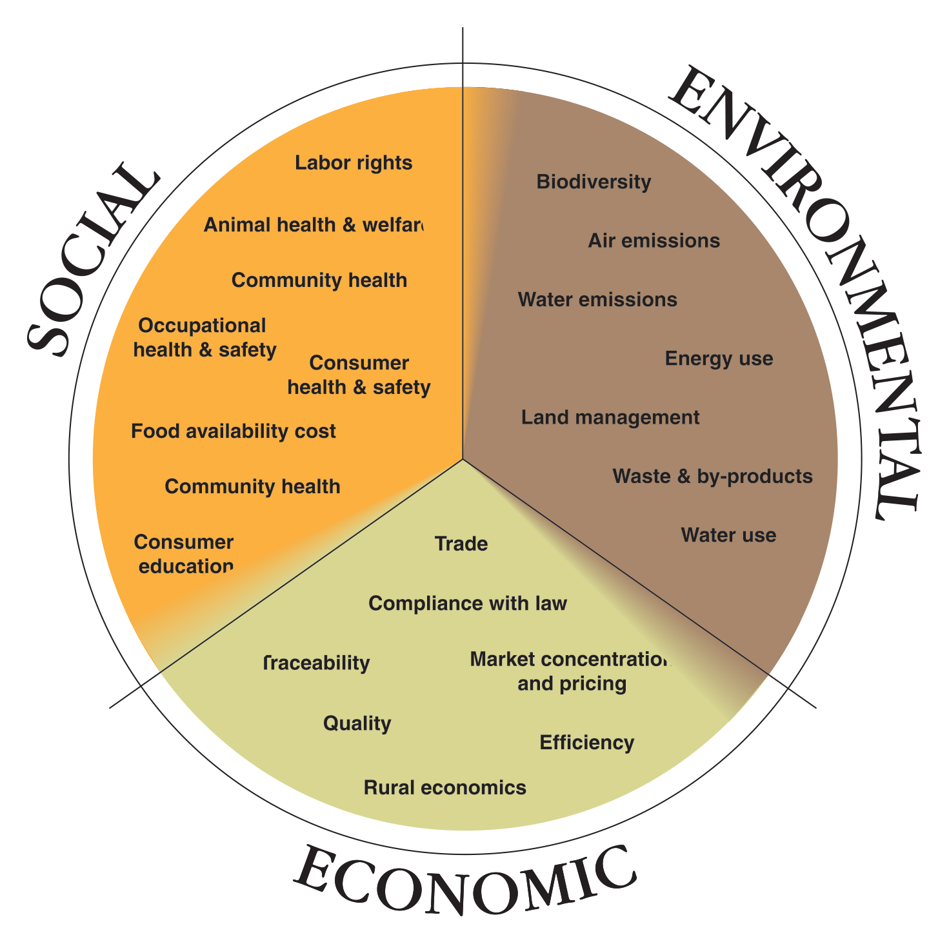
Notes:
Sustainability is complex for beef – and while everyone has a different definition of sustainability the beef industry defines it as meeting the growing global demand for by balancing environmental responsibility, economic opportunity and social diligence

Slide 3
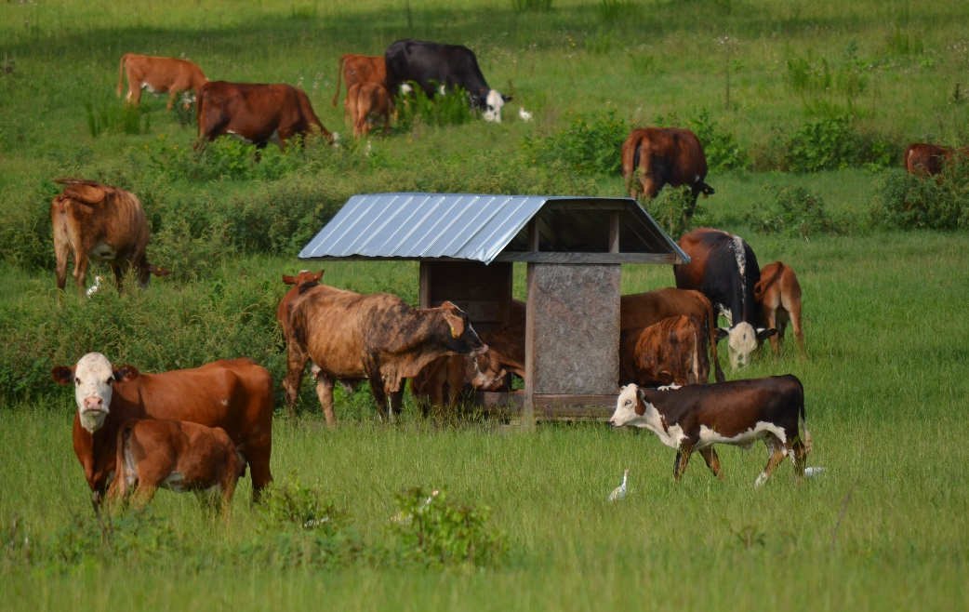
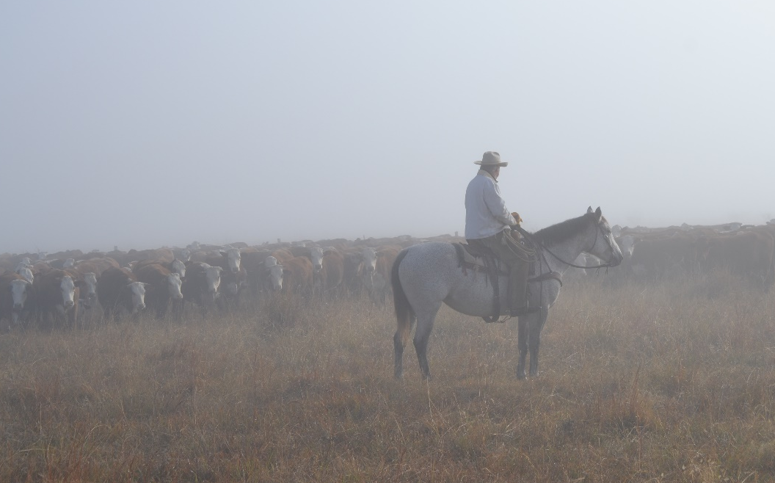
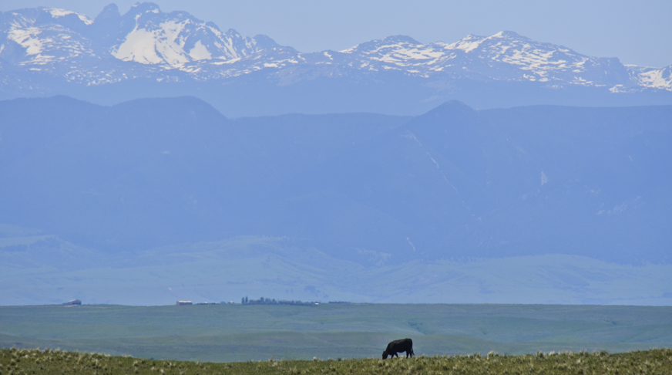
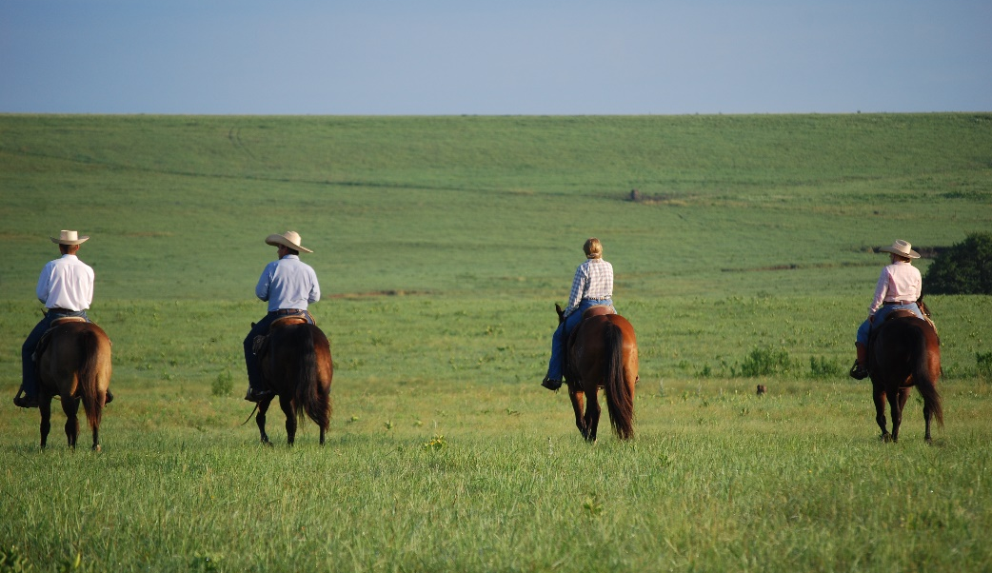
Notes:
But to the rancher it is about leaving their ranch better then when the found it. And this extends into our heritage and culture here in the US as well. Rangeland animal agriculture has long been a part of the human experience. To these cowboys their animals and their land are their life. Today, the culture and heritage of the American west largely revolves around beef production

Slide 4
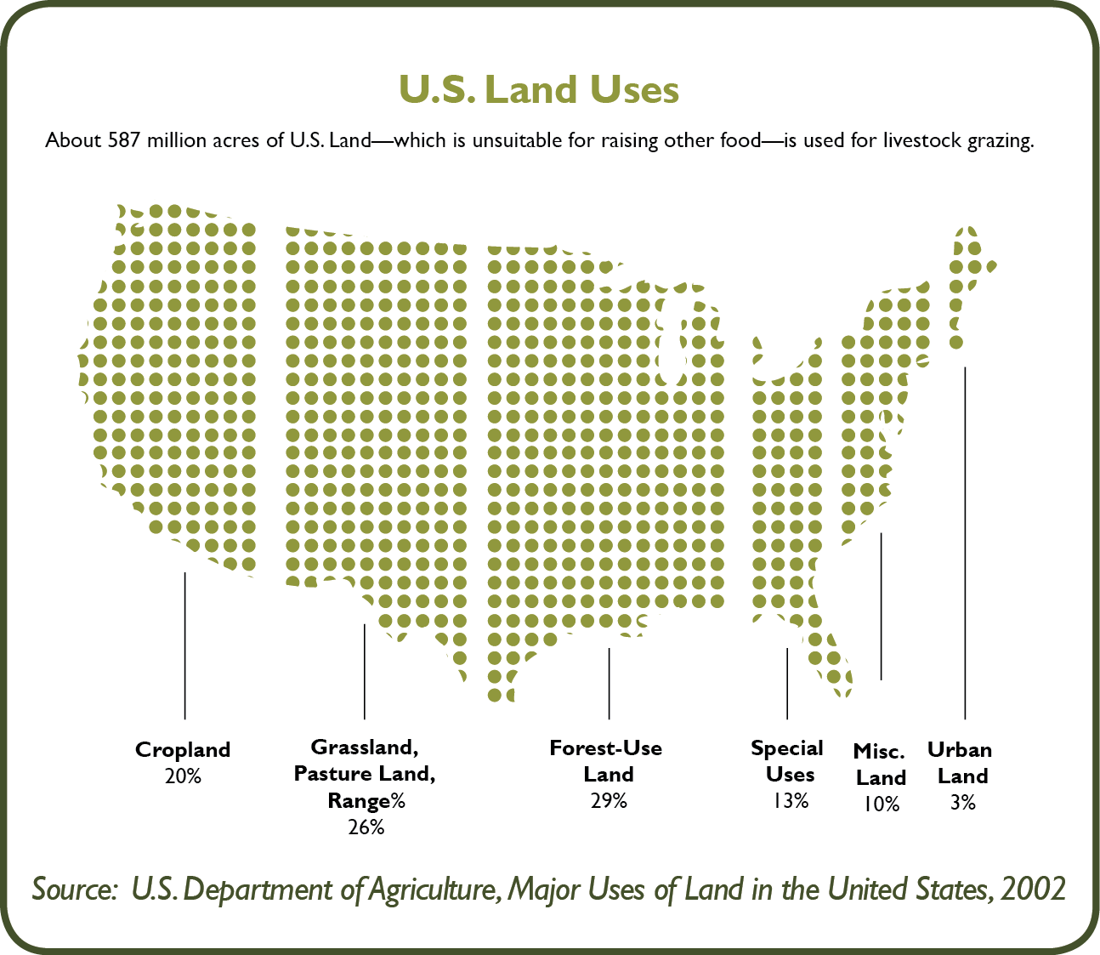
Notes:
There is no question that the management of this rangeland is an important part of beef sustainability – ½ of the land mass ion the globe and in the n the US it represent 26% of our land mass. – this 587 million acres is largely unsuitable for growing crops and cattle utilize this to and convert into protein.

Slide 5
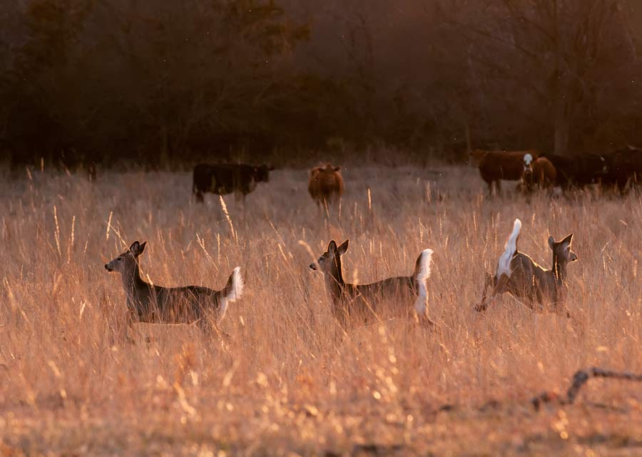
In the last 25 years 21 million acres of ranchland and pastureland has turned into developed property. David White, NRCS
Notes:
Grazing cattle on public and private lands play an important role of protecting landscapes by keeping this land safe from degradation and crop production, and it is largely threatened by the growing population.

Slide 6
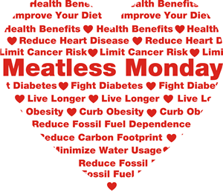
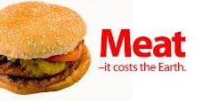
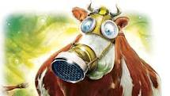
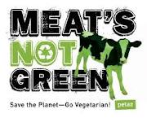
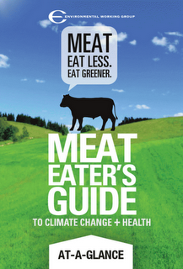
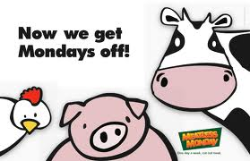
Notes:
Increasingly the political environment regarding beef production and its overall environmental impact is becoming more hostile.

Slide 7
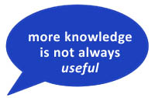
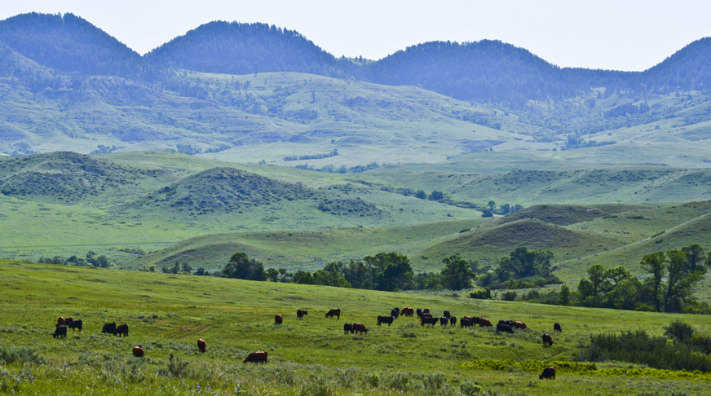
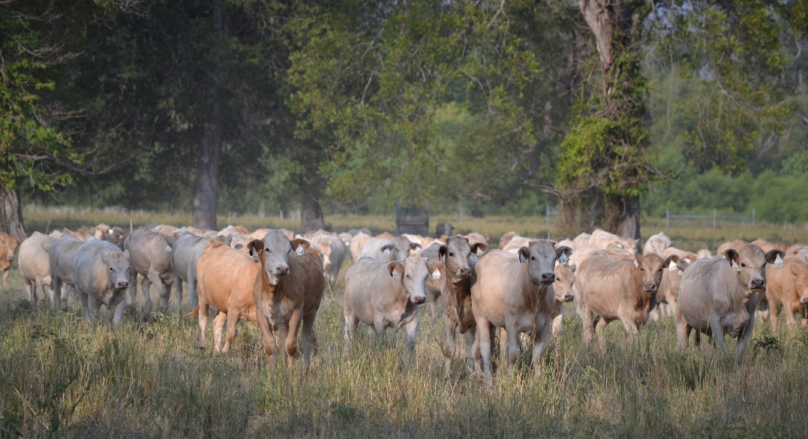
Notes:
Given the culture of the cowboy, the food the beef industry provides, that land they operate on and the fact that there is such a dichotomy of perception, opinion, and information on this subject simply reinforces the need for objective “usable science” to inform rangeland animal production and management.
Define rangeland: (international rangeland congress and the international grassland congress) “rangelands are grazed or have the potential to be grazed”

Slide 8
WHAT MAKES SCIENCE USABLE?
What makes science NOT usable?
Grazing studied as an “on-off switch”
400 page reporting documents
Notes:
So much like the presenters before me we came together to discuss ways in which we could make science more usuable – which of course begs the question - what is usable? I think it is often easier from and animal science prespective to talk about what is NOT useful – things like grazing studies that are a simple on-off switch rather than looking at altertive approaches and ofcourse the 400 page doc that no producer will sit down to read.

Slide 9
WHAT MAKES SCIENCE USABLE?
Who uses the information?
Land managers, scientists
Gap in communication
Notes:
The next logical question is who will use the information?

Slide 10
WHAT MAKES SCIENCE USABLE?
Science that…
Addresses practical issues
Interaction between rangeland and the animal
COMMUNICATED EFFECTIVLEY
Notes:
And finally we conclude that usuable sicence addresses practical issues that land user have an interest in, it explores the complete interation and is communicated effectively and in a timely matter.

Slide 11
?
Notes:
How do we advance this notion of usable science.
Our group was composed of individuals from the livestock industry, two universities, and a non-profit conservation organization. As described in detail by Lori Hidinger earlier in this issue, the animal team was part of a larger group of rangeland professionals that met in Ardmore, OK to develop a broad research agenda intended to address the need for usable science pertaining to rangelands. After hearing perspectives from constituent groups such as producers, NGO’s, and funding agencies we broke into focus groups.

Slide 12
USABLE SCIENCE FOR MANAGING RANGELANDS
Proactive drought planning
Matching production systems to the resource base
Comprehensive synthesis and effective communication of livestock impacts on rangelands
Notes:
From the larger group brainstorm there were three issues that our group targeted.

Slide 13
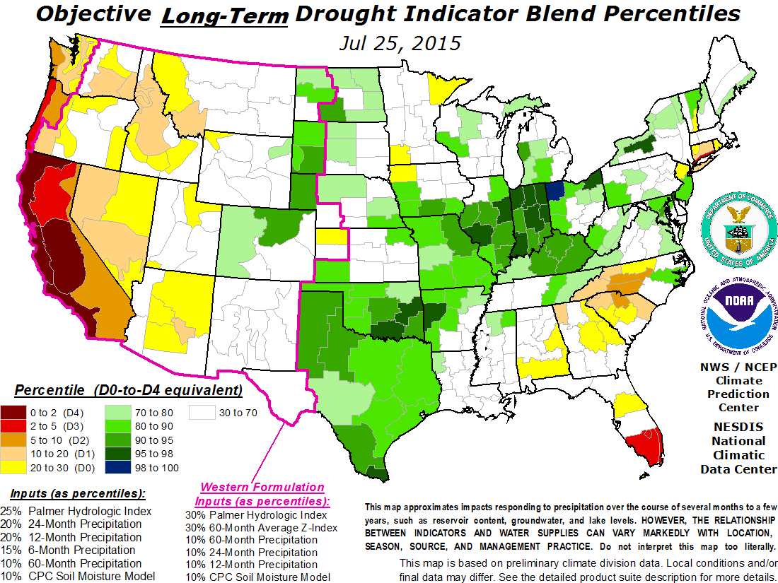
DROUGHT PLANNING
Notes:
Effective drought planning does not only help protect land from overuse – but also protects the ranching business. To help make progress in this area we proposed additional research that included….
User friendly site specific tools make planning simpler
More accurate drought prediction scales
Case studies of successful stories that also demonstrate economic incentive

Slide 14
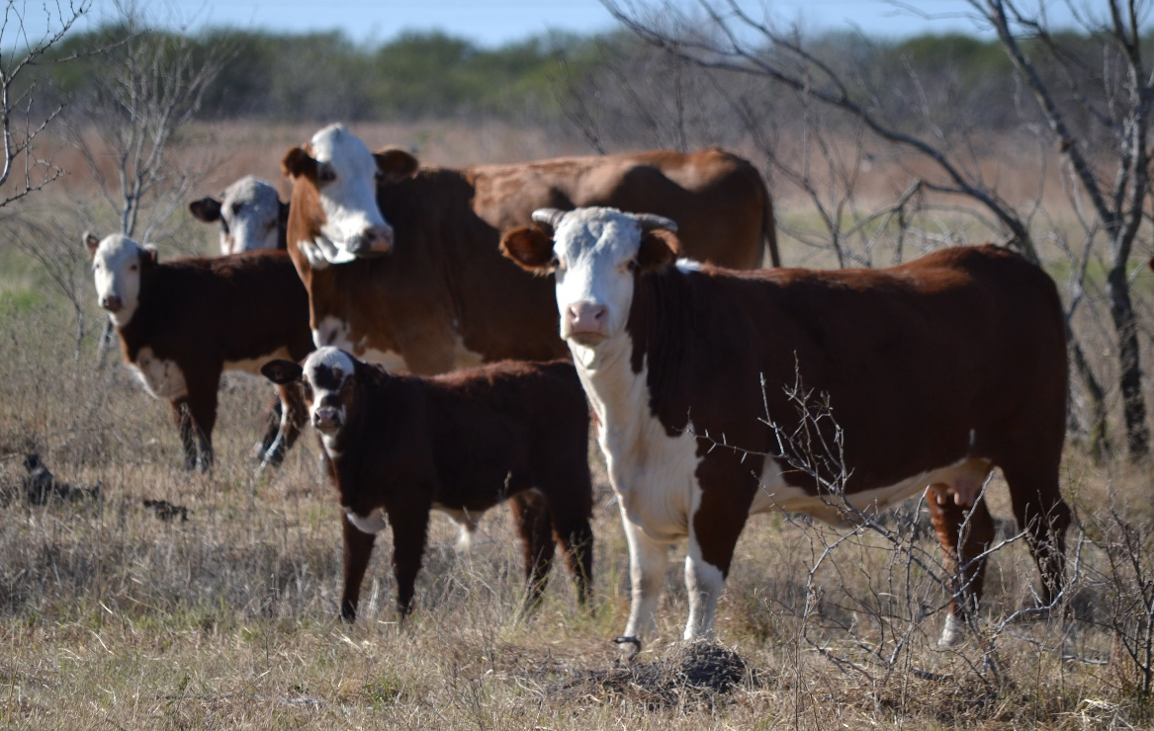
MATCHING PRODUCTION SYSTEMS TO THE RESOURCE BASE
Notes:
Our group agreed that optimization should be the goal for rangeland management not maximization. Its clear from these photos that a one size fits all approach to sustainable rangleands wont work – cattle breed and life stage heavily influence the resources that animal may need – however there is very little research in this area.

Slide 15
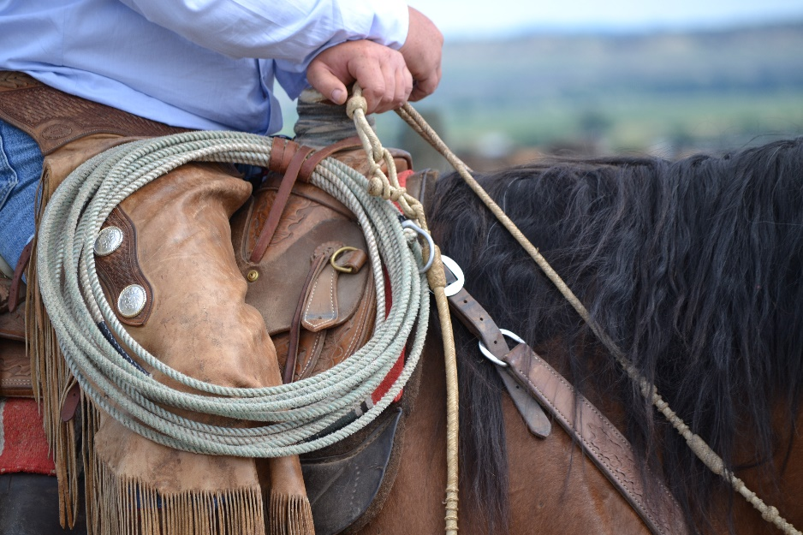
OPTIMIZE
Properly match animals
Stocking rate flexibility
Animal behavior
Notes:
So the research questions we developed to better address this issue are….

Slide 16
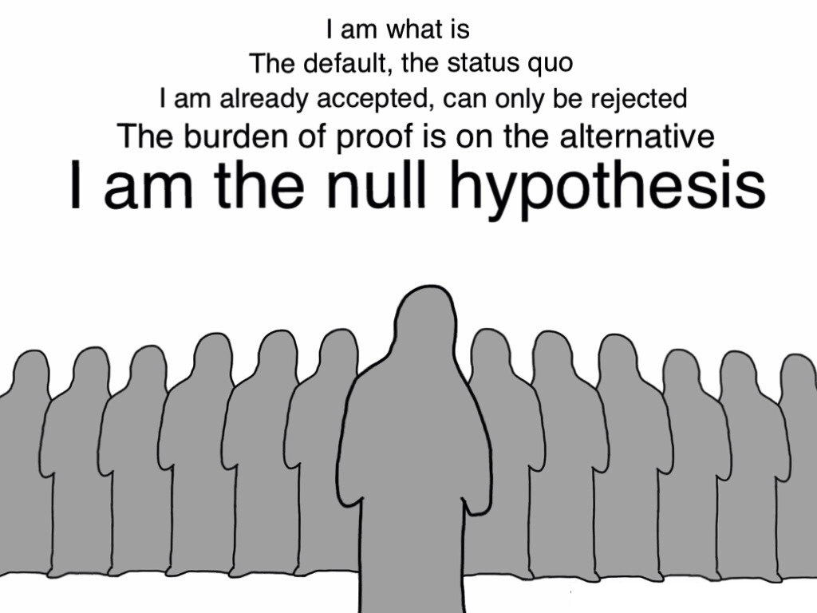
COMPRHENSIVE SYNTEHSIS OF IMPACTS
Notes:
Our second issues really had two parts – the first was to better synthesize the work that did not yield significant result – perhaps some of these more intergrated research questions had already been discovered but were not published since they may have actually been working

Slide 17
Notes:
And finally, how can we better communicate this to the approirate audience in a way they can understand and so it provides them with value and tangible result.

Slide 18
Notes:
Part of that is working to develop better partnerships with land users, academics, and comservation organizations to work toward a common goal.

Slide 19
9 billion people by 2050
70 % more food
Notes:
Because in the end we have a tremendous challenge- perhaps the greatest of our time and we need to feed these people who will demand more protein than ever before…

Slide 20
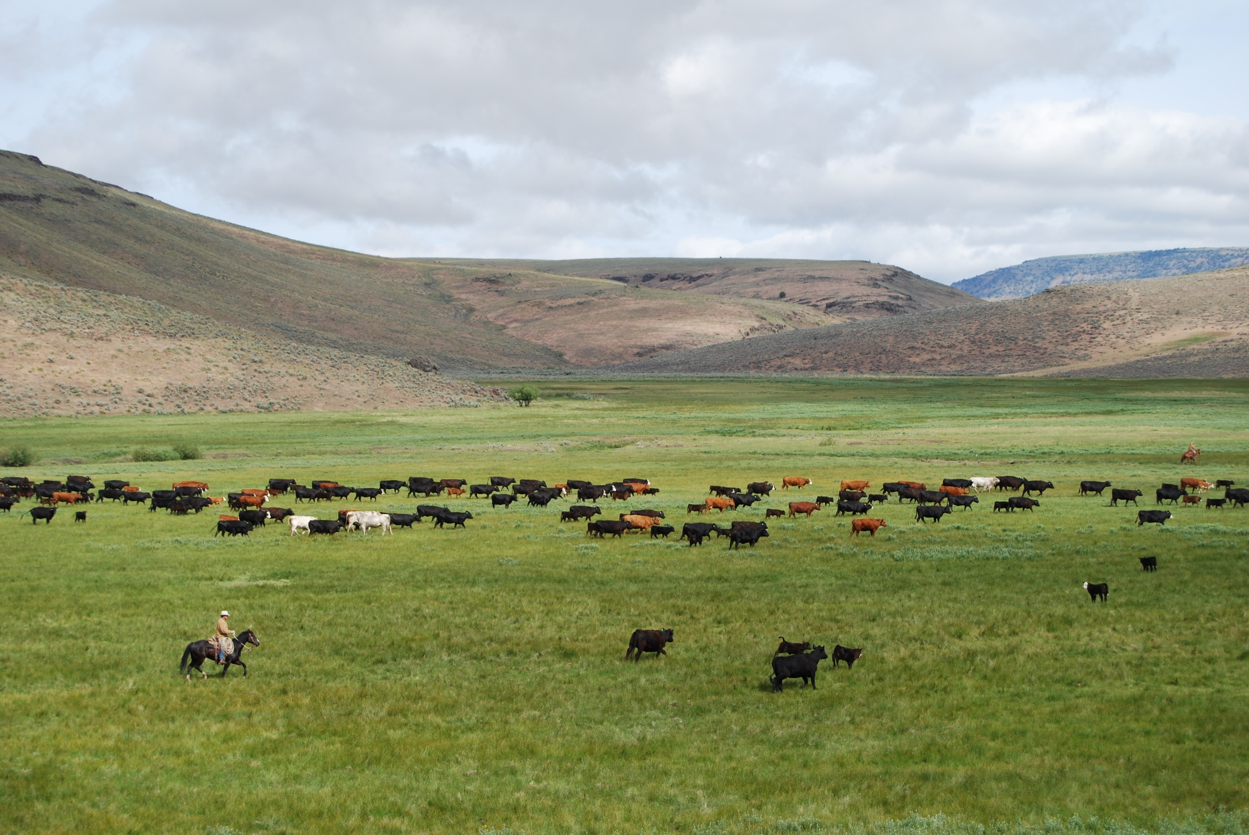
Notes:
While still maintaining these precious rangelands.

