Slide 1
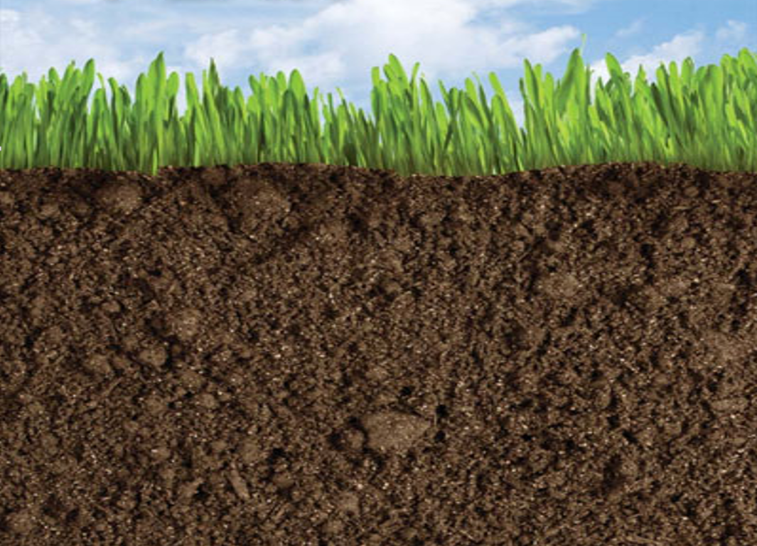
Future Directions of Usable Science for Sustainable Rangelands: Soil Health
Chad Ellis

Slide 2
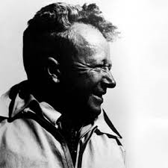
Lloyd Noble
Founder of the
Samuel Roberts Noble Foundation
Est. 1940

Slide 3
Underappreciated
Belowground “black-box” mentality often attributed to soils
Black-Box
= Soil
Notes:
The obscurity of soils was reflected in the prioritization of the 142 identified issues from the usable science Workshop held at the Noble FDN, early June 2014.
For the 5 groups(Water, animals, Vegetation, Scio-eco., and Soils) only 1 soil issue was in the top 20% (and it ranked #28) The next was a cluster od soil issues ranking 50-52 and then ended with 141 and 142. and, that being microbial communities.

Slide 4
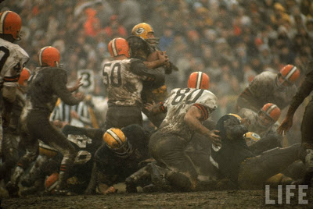
Obscurity of Soils
Offensive Line = Soil
Notes:
Like the Offensive lineman on a football team, soil toils in obscurity. Soils are often under-appreciated and taken for granted. For, an offensive lineman, notoriety is obtained by number of pancake blocks and the lack of sacks allowed, as well as flagged for a penalty on a game-changing play.
Likewise, soil receives little press until it garners public attention when it is lost from land do to wind (drought) or by water (floods), or when mismanagement leads to degradation.

Slide 5
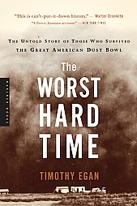
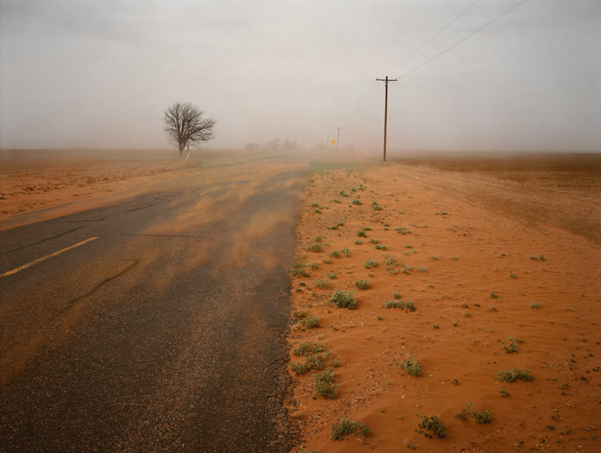
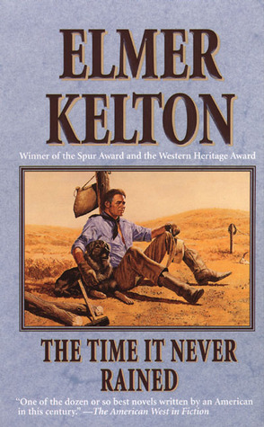
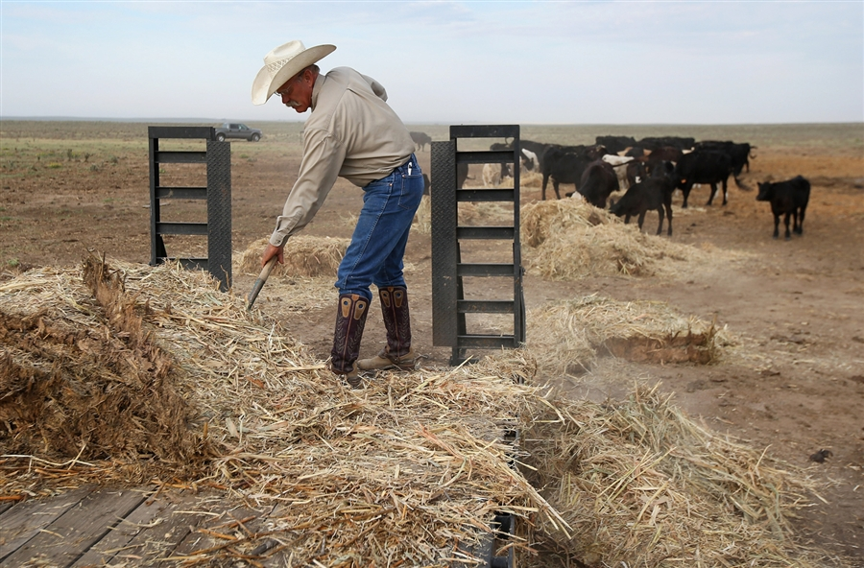
Transformation Changes Get Attention
Accelerated erosion with “benchmark” events such as Dust Bowl and 1950s drought
Provide context for importance of maintaining healthy soils
Notes:
Benchmark events such as the 1930’s dust bowl remain entrenched for land managers in how drought can lead to widespread wind erosion or water erosion and this is expected to potentially increase in extreme rain fall events

Slide 6
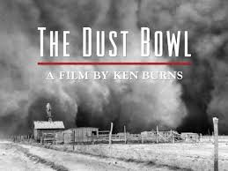
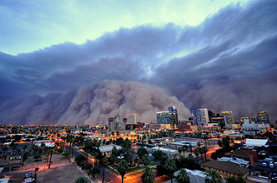
Current State of Soil Health?
1930’s
June 27th, 2015
Phoenix

Slide 7
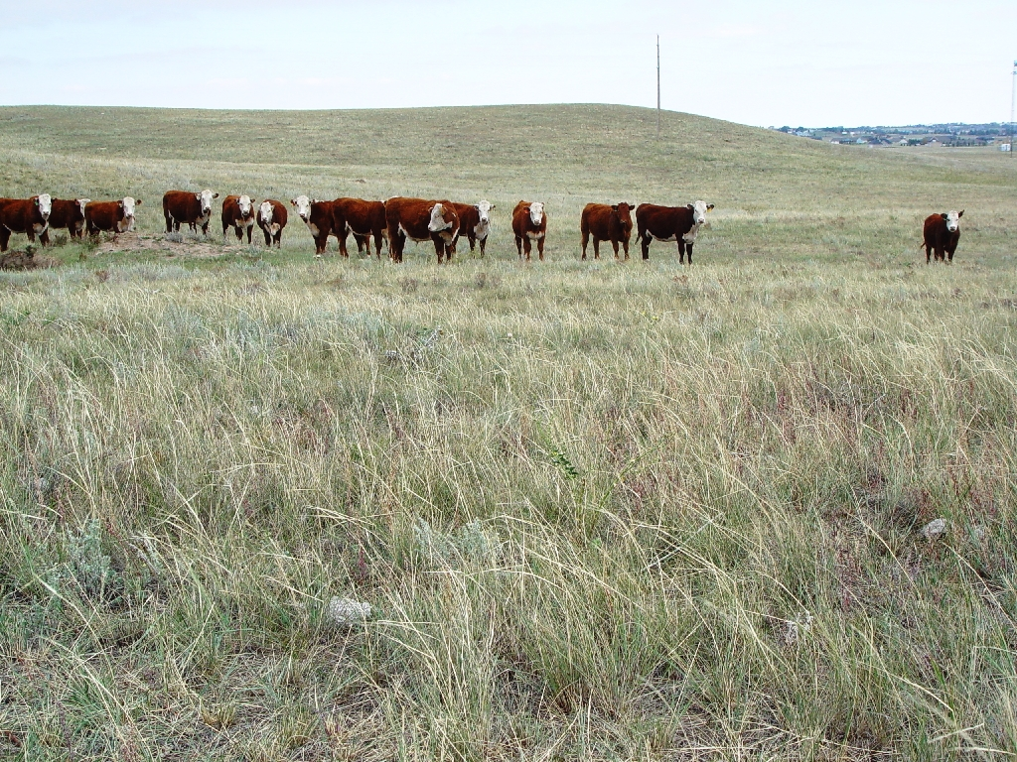
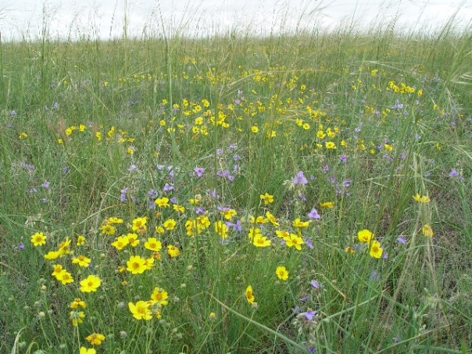
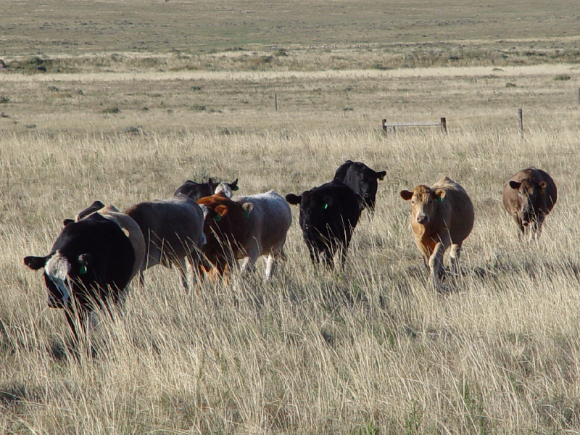
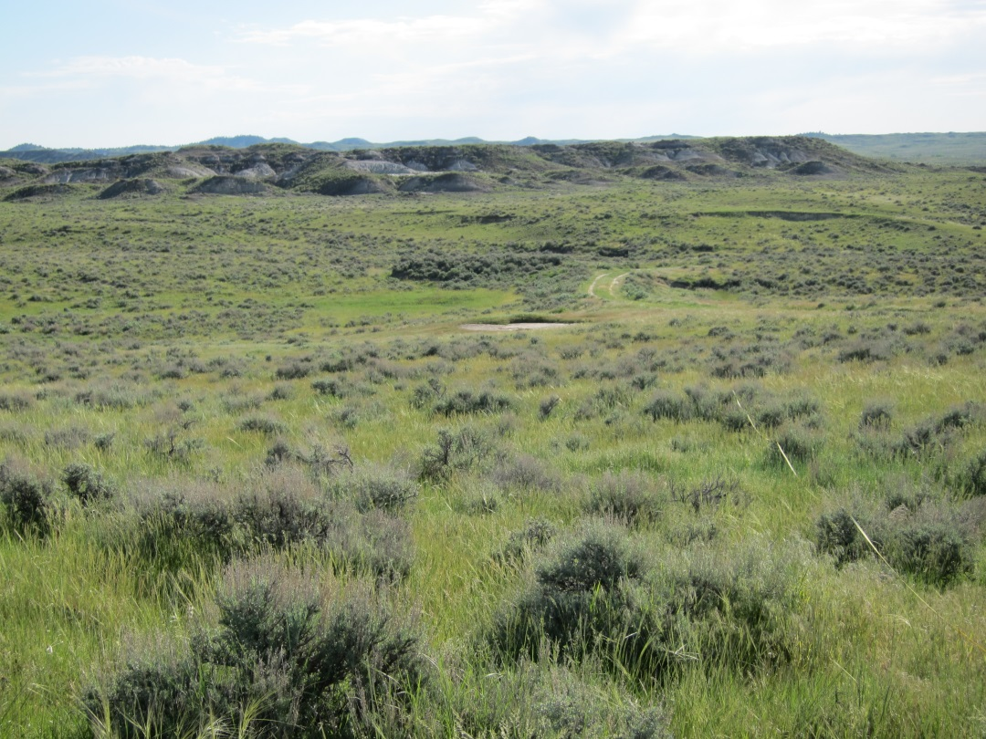
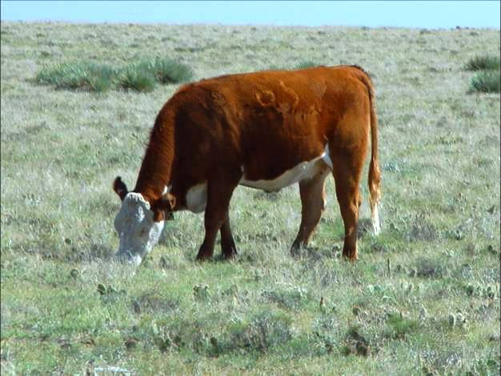
Why is Soil Health Important?
Healthy soils are fundamental to sustainable rangelands

Slide 8
5 Principles to Improve Soil Health
Armor the Soil
Minimize Disturbance
Plant Diversity
Keep a Living Root Year Round
Livestock Integration

Slide 9
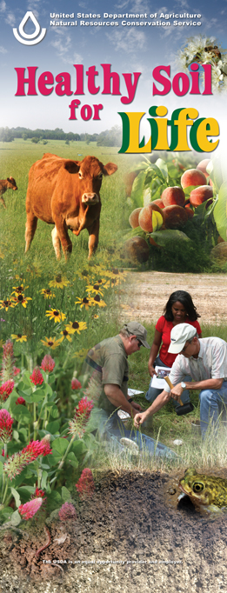
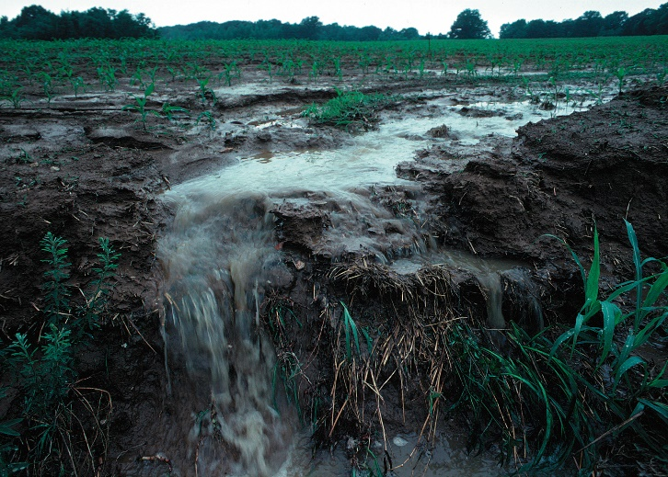
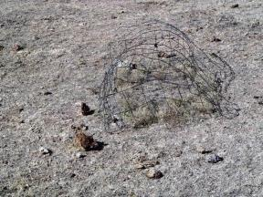
Soil Health and Co-benefits
Enhanced soil water holding capacity, increased nutrient cycling
Increases resilience of rangelands to weather variability and predicted climate change
Notes:
There is a tremendous interest, both from producers and USDA, in augmenting soil health (physical, chemical, and biological components) with appropriate conservation practices to increase production capacity and ecosystem services through enhanced soil water holding capacity, increased nutrient cycling and great resilience to weather variability and predicted climate changes.

Slide 10
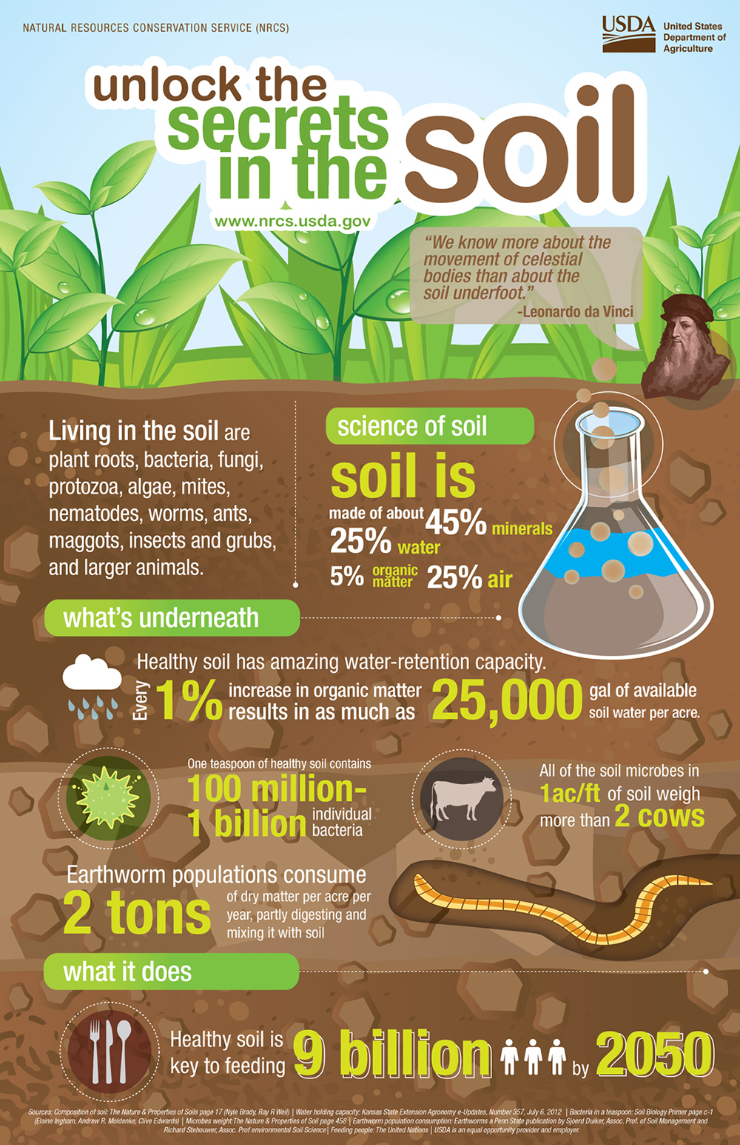
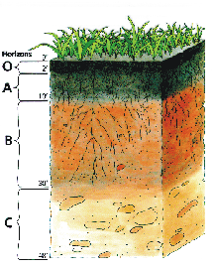
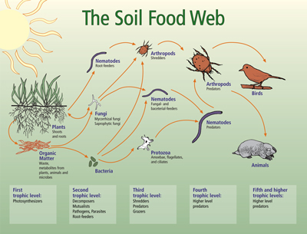
Other Directions?

Slide 11
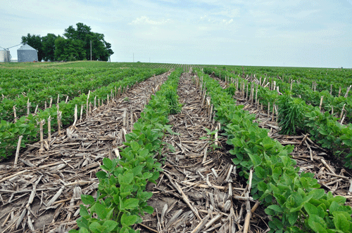
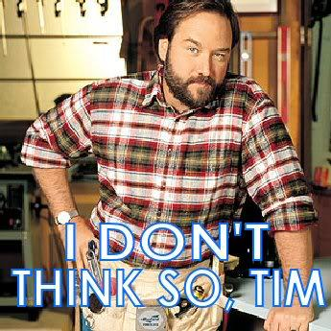
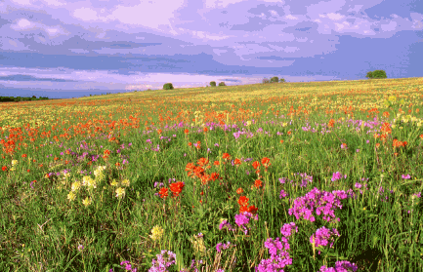
Soil Health: Cropland vs. Rangeland
Vs.
Notes:
Primary relevant differences between croplands and rangelands for soil health include:
Intensive management for crops vs. extensive management for rangelands
Annual plants for crops vs. perennial plants in rangelands
Croplands are mostly found in more mesic environments (along with introduced pastures) vs rangelands are largely in more semiarid and arid environments

Slide 12
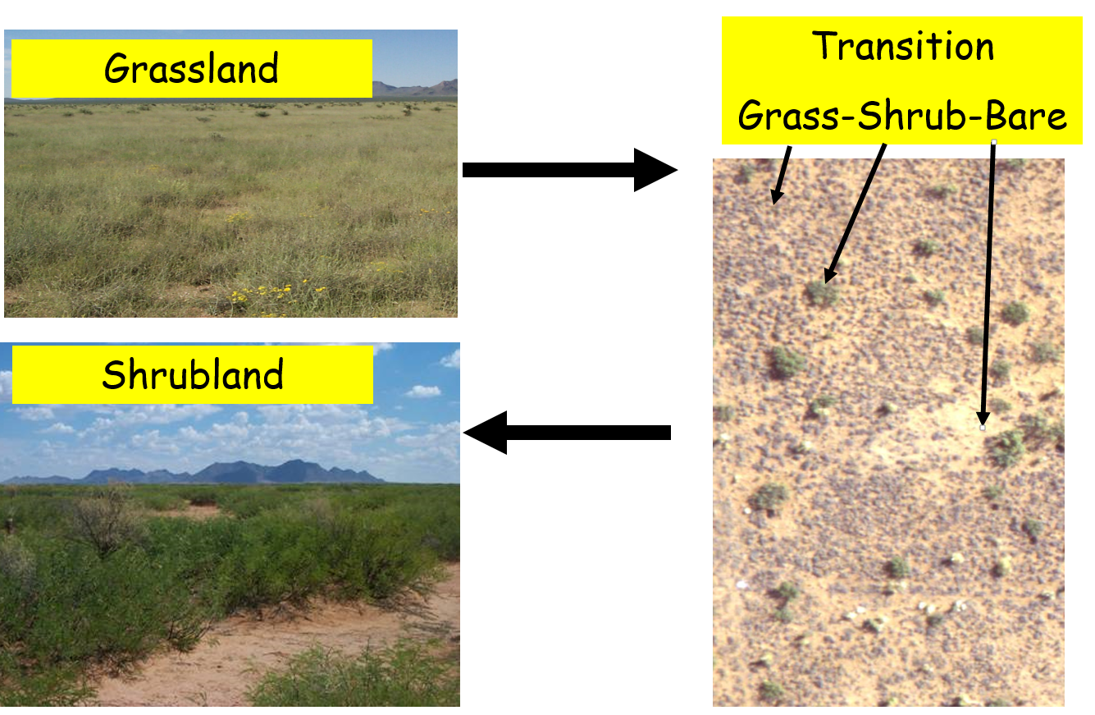
Rangeland Dynamics
Notes:
Even within the broad category of rangelands, these ecosystems are markedly different in terms of their soils and climate (exemplified by the mollisols of the Great Plains vs the aridisols of the Great Basin)
Vegetation physiognomy (grasslands, shrublands, prairies, savannas)
Evolutionary history (Great Plains with large migratory herbivore herds vs Great Basin with small-sized browsers)
Together, these factors define the inherent resistance and responses of regions and individual sites to grazing.

Slide 13
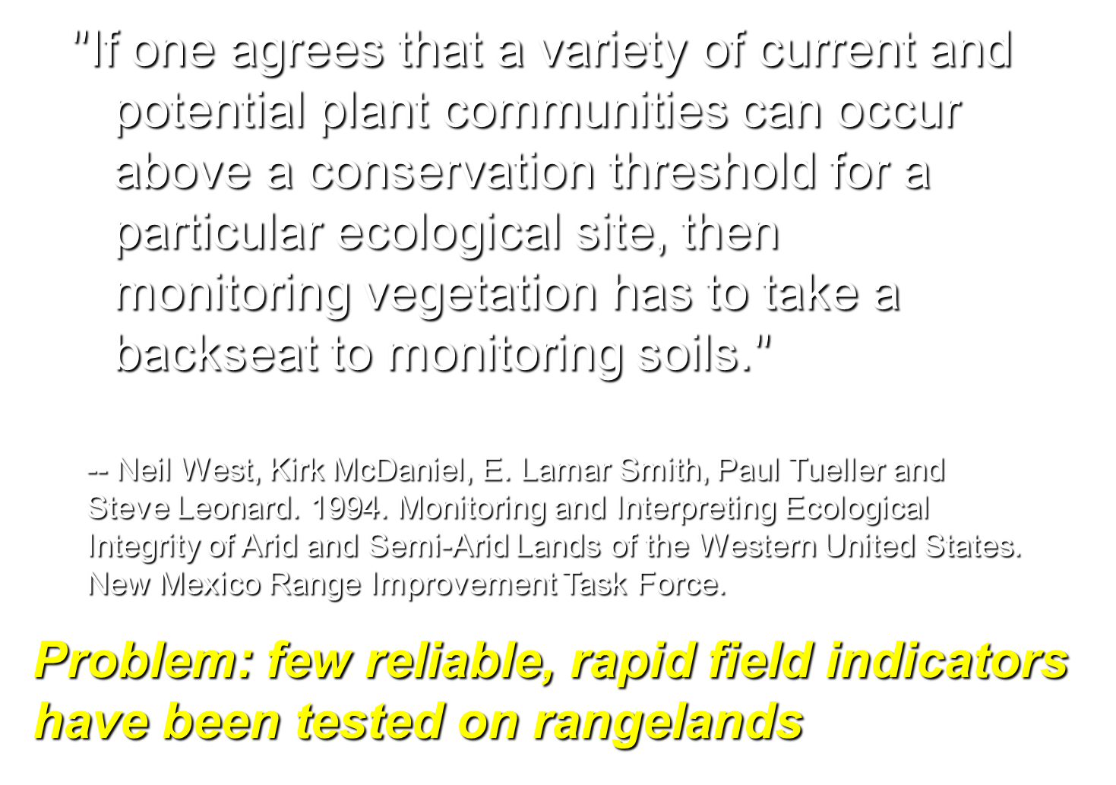

Slide 14
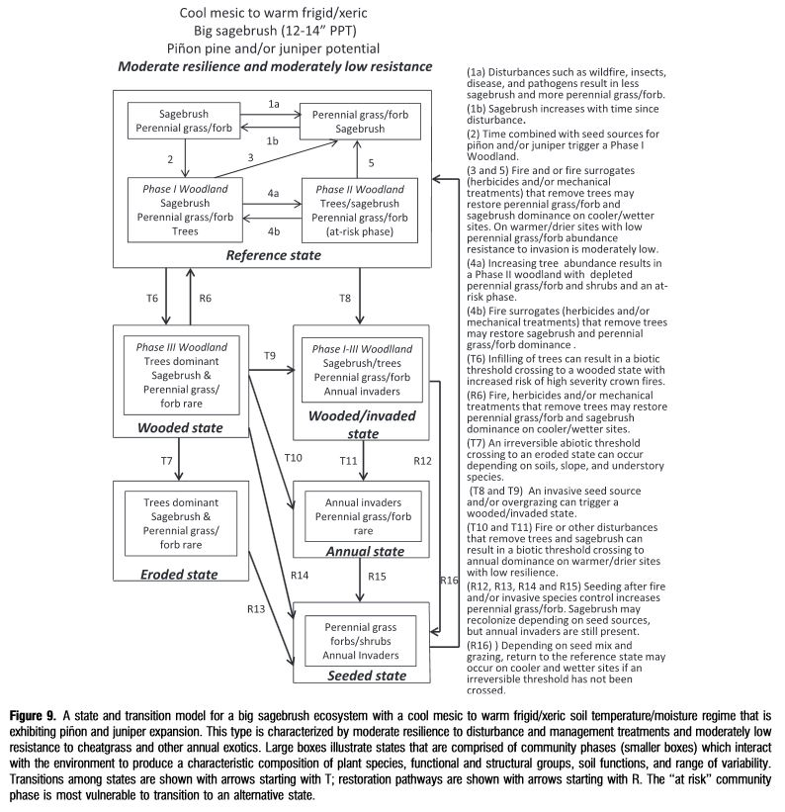
Future Directions: Soil Health
Characterizations of soil health indicators for sensitivity levels that affect transitions/thresholds of state-and-transition models
Chambers et al 2014 REM
Notes:
Differential responses to grazing, defined as ecological state changes, for rangelands are demonstrated by the conversion of sagebrush shrublands in Nevada to monocultures of invasive annual grasses, and the conversion of desert grasslands in New Mexico to sparse shrublands with high amounts of bareground cover. Much more subtle examples of vegetation change are exhibited in much of the Great Palins where a long evolutionary history of grazing by large herbivores results in a slow, gradual changes to vegetation even with substantial differences in stocking rates (example still no discernable state change with heavy vs. light stocking in northern mixed prairie after 34 yrs of experimental season-long grazing, Porensky et. Al.)

Slide 15
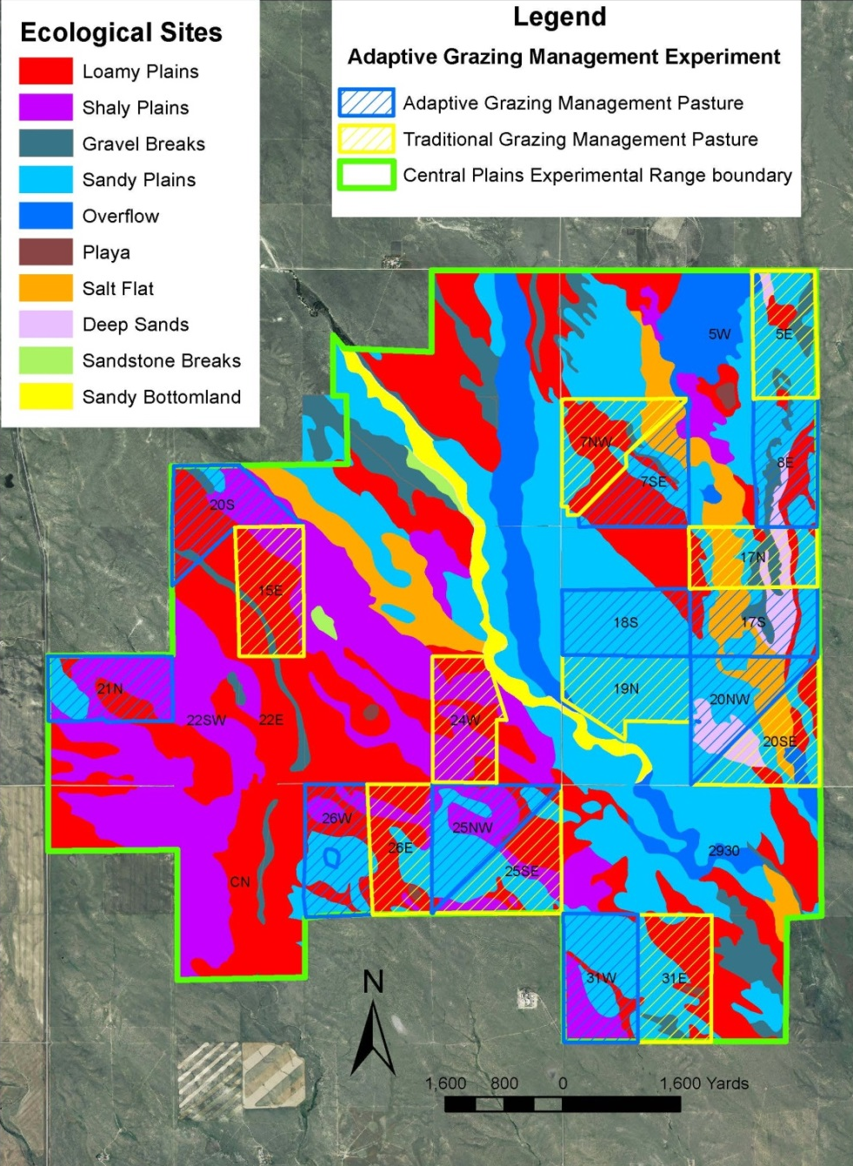
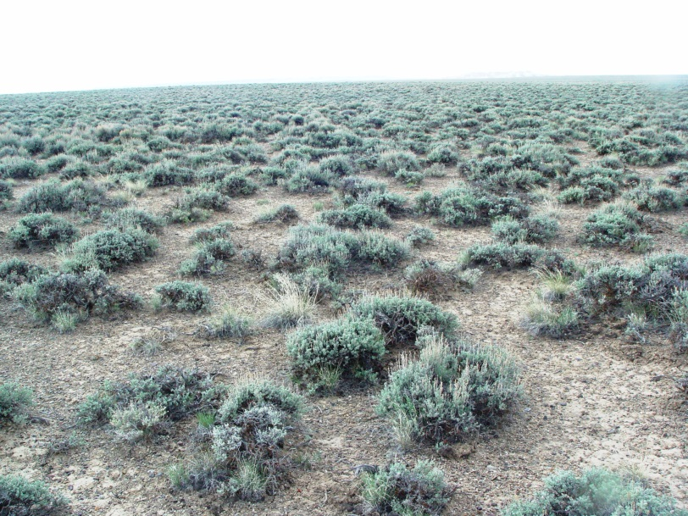
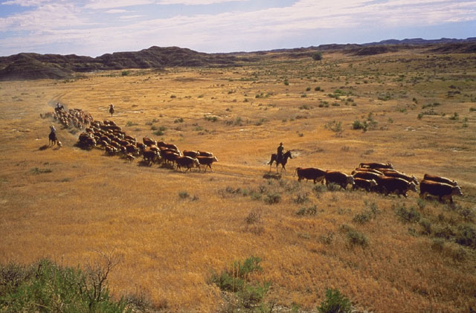
Future Directions: Soil Health
Spatial aspects of soil health indicators
Notes:
Differences among rangeland ecosystems at the continental scale are often confounded at the local scale by the high degree of spatial heterogeneity of soils (landscape position, aspect, geological influences, historical/current erosion) and temporal variability of environmental factors, primarily precipitation in these water-limited systems (droughts to downpours).
Although this spatial and temporal diversity is common in agricultural systems around the world, modern agronomic techniques have homogenized croplands and pasturelands with substantial inputs and intensive management.
For rangelands, however there remains a key need to evaluate possible metrics of soil health for sensitivity as early warning indicators to determine transitions/thresholds on state-and-transition models. In transition-prone ecosystem with high resilience, these soil health based indicators could be used to implement management changes to prevent undesirable transitions.

Slide 16
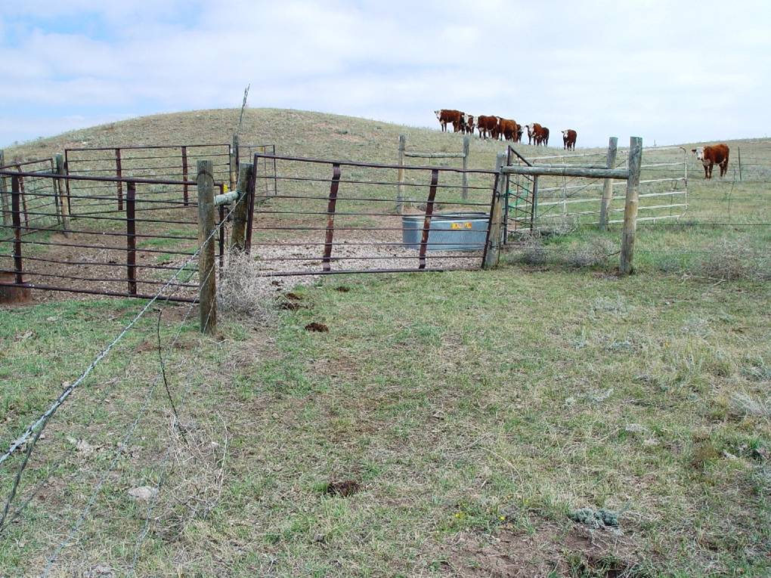
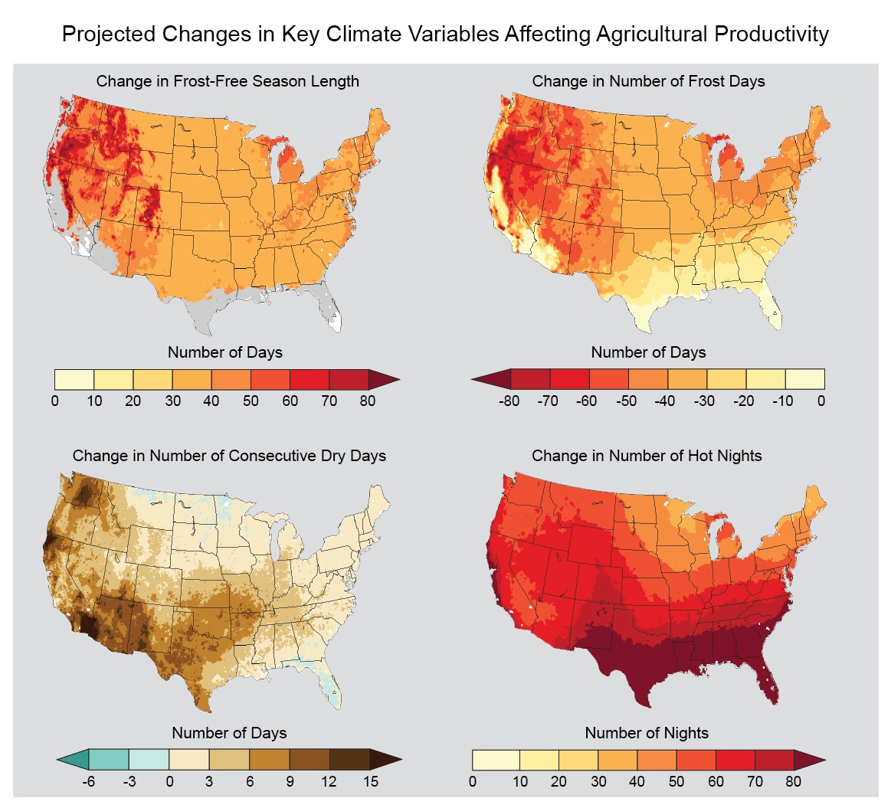
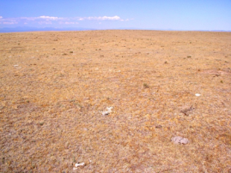
Future Directions: Soil Health
Influences of management practices, predicted climate change and extreme events
National Climate Assessment 2014
Notes:
Given that growing seasons in rangeland ecosystems are generally short (typically less than half a year), annual net primary productivity is low and management X environment interactions dominate ecosytem processes, it is not surprising that low organic matter soils (typically less than 1%) sequester limited organic carbon. Proper management focus on rangelands, therefore, largely addresses conservation of existing soil resources and preventing degradation of these soil resources since enhancement of soil resources, differentiating between “average” and “excellent” management on soil responses can be problematic and different given that discernable effects are often not readily apparent.
Climatic limitations (including predicted changes in temperatures and precipitation, as well as an increase in frequency of extreme events, of rangelands ecosystems often result in lower productive capacity of many systems, thus precluding the use of input driven management techniques and philosophies.
As, such metrics of soil health (including, chemical, physical and biological) will need to have very high accuracy and precision to effectively demonstrate “true” changes in these metrics attributable to conservation practices over time.

Slide 17
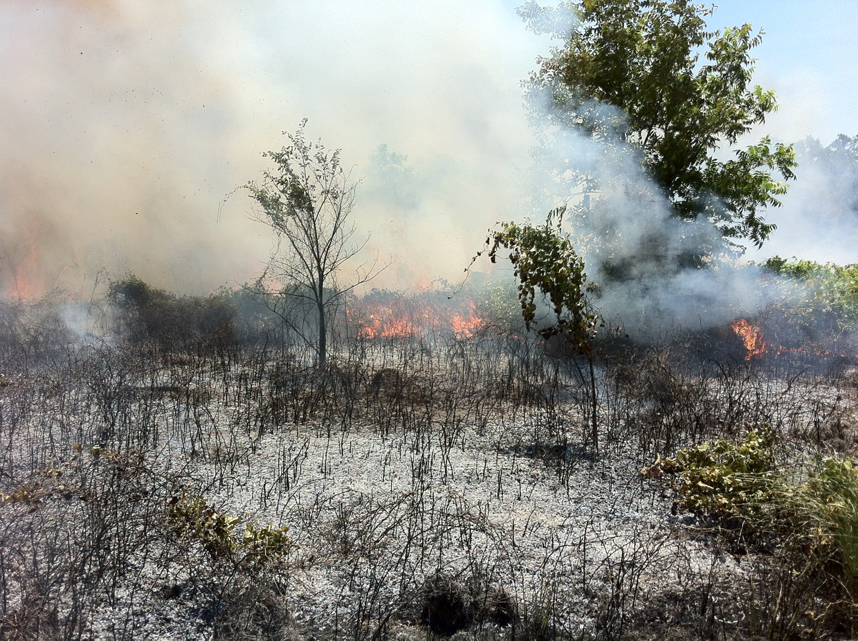
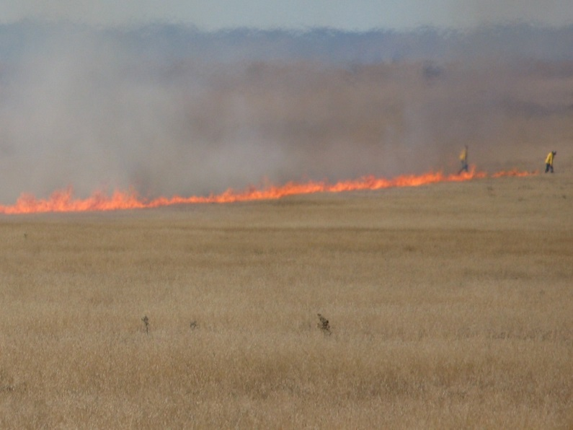
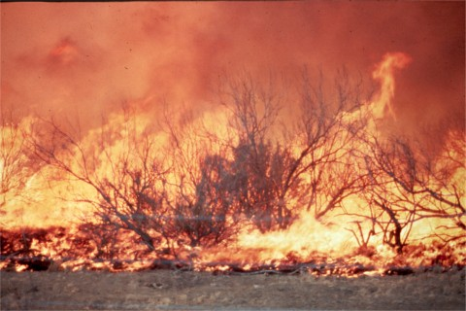
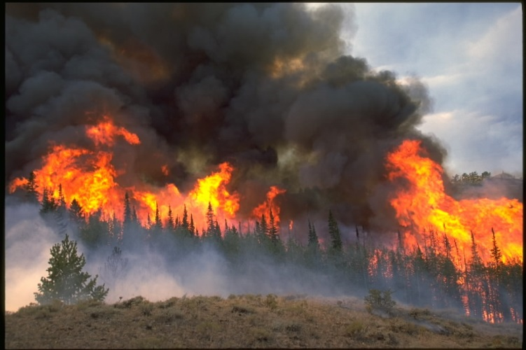
Future Directions: Soil Health
Is soil health affected by prescribed fire and wildfires?
Notes:
The responses of soils and hydrology to fire are highly variable, but water repellency and resulting runoff and soil erosion with greater sediment loads are negative effects of extreme soil heating that occurs mostly under intense wildfires where fire has been absent for many years or in ecosystems with less evolutionary importance of fire.
In a rangeland synthesis on prescribed fire (Sam Fuhlendorf) as a conservation practice in the US, only 17 studies were identified where soil responses were addressed.
Spatial pattern of soil biogeochemical resources are usually unaffected by burning, either prescribed fires or single intense wildfire event. However, intense wildfires do affect small-scale (microsites) surface characteristics associated with hydrology, temperature and erosion. Increasing frequency of wildfires could alter the spatial pattern of soil biogeochemical resources as well. Additionally, more wildfires can influence landscape changes associated with runoff and soil erosion, largely mediated through plant compositional modifications (conversion of sagebrush grassland to monocultures of invasive annual grasses).

Slide 18
What is the Future for Soil Health and Usable Science?
Notes:
While soils, and soil health, have often toiled in obscurity, two major events in 2015 represent a dramatic change in notoriety, making this a watershed year for soil in term of press attention.
First, United Nations General Assembly has declared 2015 as the International Year of the Soil
Second, USDA Secretary Tom Vilsack announced on April 23rd, 2015 that Soil Health was one of the ten USDA building blocks for Climate Smart Agriculture and Forest Strategy
As a result of these two efforts, the future for soil health for usable science is quite promising for land managers, innovative producers and climate-informed decision makers.

Slide 19
Evolution of Soils

Slide 20
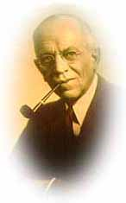
“Land, then, is not merely soil; it is a fountain of energy flowing through a circuit of soils, plants, and animals.” - Aldo Leopold, A Sand County Almanac, 1949

