Slide 1

Useful, usable, actionable science: A perspective for rangeland sustainability
Netra Chhetri
Arizona State University
Notes:
These terms are hardly new. At the heart of this relationship is the ides that science, especially publically funded science, should play a fundamental role in supporting the understanding, design and solutions for social problems

Slide 2
U2 and actionable science IS NOT NEW
……when facts are uncertain, values in dispute, stakes high, and decision urgent.
Notes:
emergence of post-normal science emphasizing the importance of solutions

Slide 3
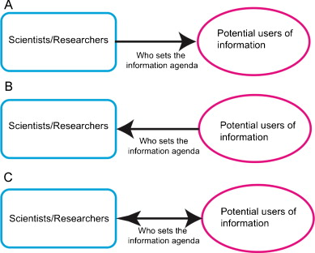
……usability depends on who sets the agenda for its production & dissemination
Iterative feedback between the producer & users is critical to creating usable science
Source: Dilling and Carmen Lemos, Global Environmental Change, 2011:680-689

Slide 4
Three attributes of usable science
Salience: relevance of information in question;
Credibility: technical quality of information;
Legitimacy: interest of users in mind (or at minimum)
Source: Cash and Buizer, 2005, The National Academies Press
Notes:
Salience – do we have enough information about the users, especially in the form and time of the information use? SO it relates to perceived …
Credibility – does the providers of knowledge provide information that is perceived to be valid, accurate, tested? And addresses perceived…
Legitimacy – is not simply the vehicle for pushing the agenda and the interest of the actors. It concerns perception that the systems in which the knowledge is generated has the….

Slide 5
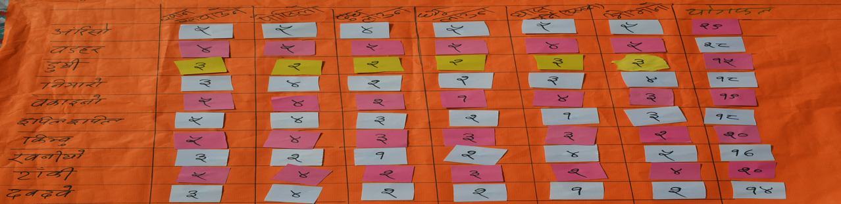

Slide 6
How to make your research demand driven?
Responding to problems
Equity in research priorities
Imagining solutions for future challenge
Knowledge co-creation

Slide 7
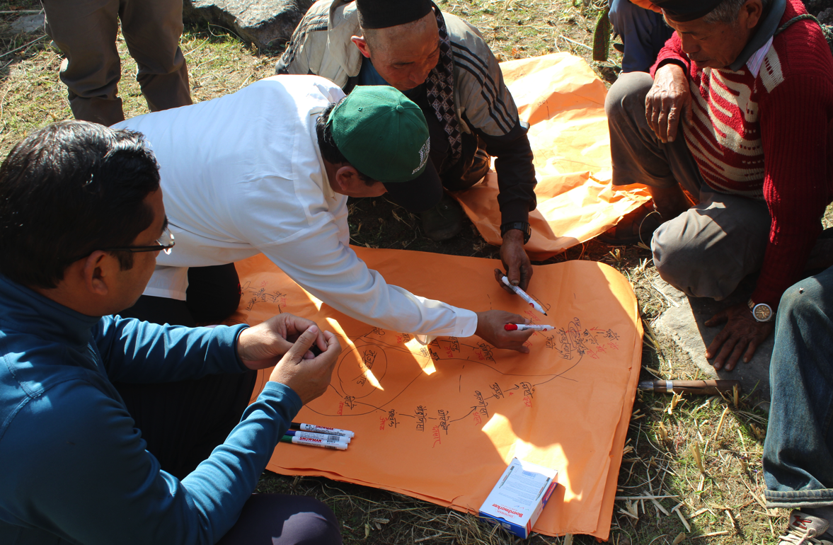
Participatory approach to knowledge co-creation

Slide 8
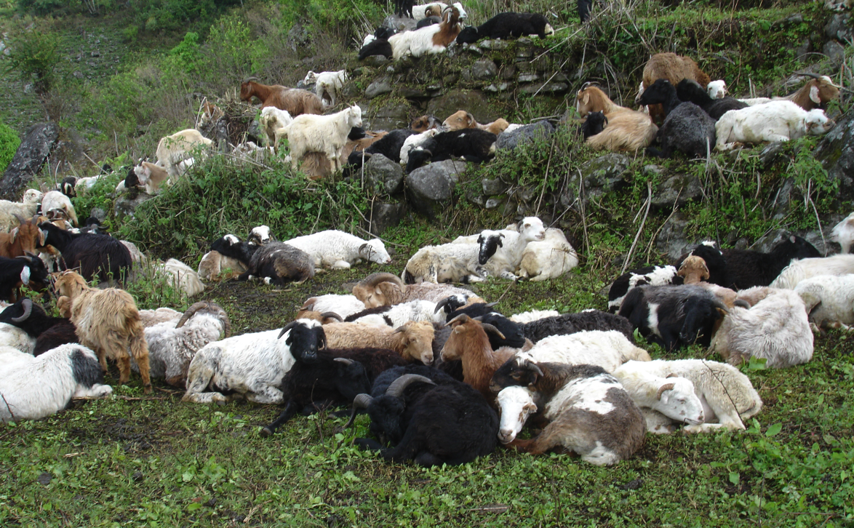
Geographers at work

Slide 9
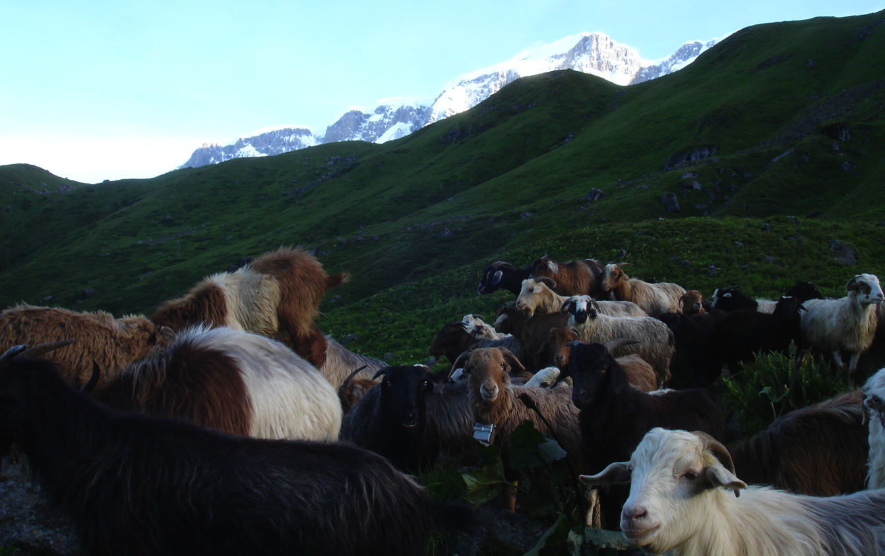
Geographers at work

