Slide 1


Ignite 11: Future Directions of Usable Science for Sustainable Rangelands
Principles and Concepts of Usable Science for Sustainable Rangelands
Lori Hidinger
Managing Director, Consortium for Science, Policy & Outcomes
School for the Future of Innovation in Socity
Arizona State University
www.cspo.org @lorihidinger @CSPO_ASU
Booth #422

Slide 2
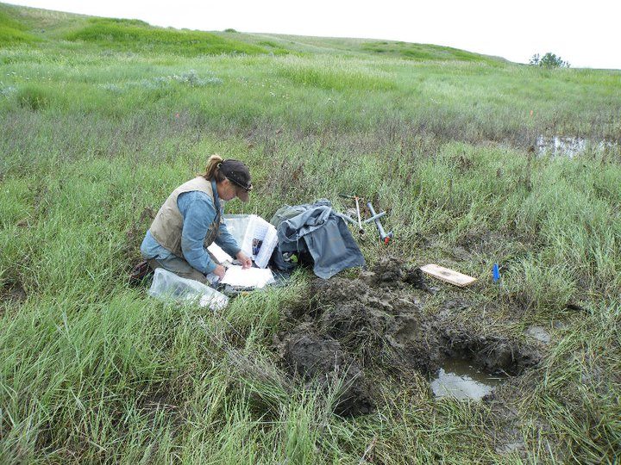
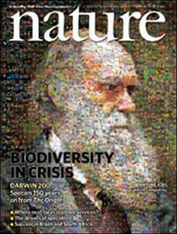
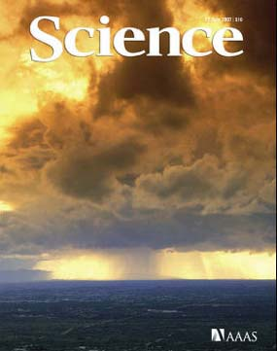
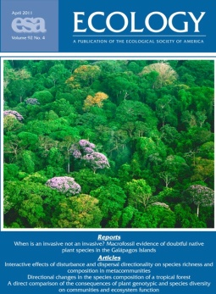
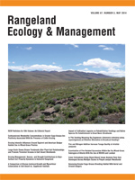
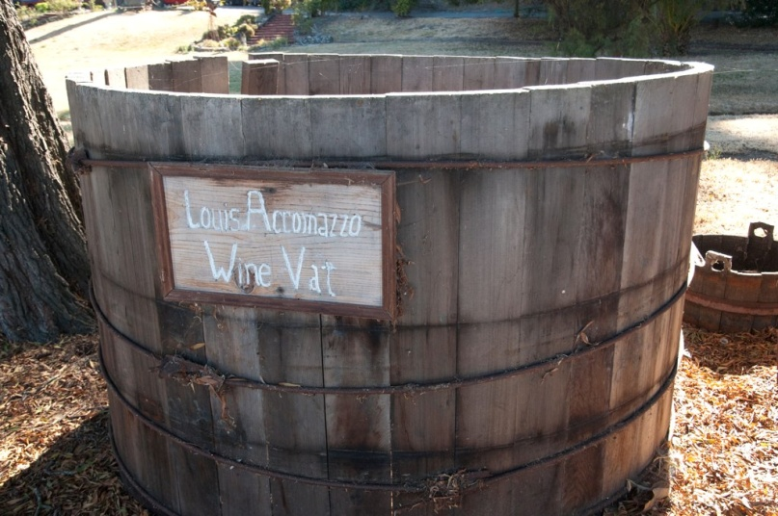
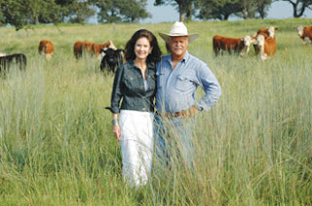
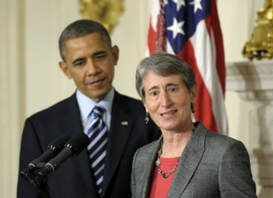
The Linear Model of Science-User Interaction
Big Vat o’ Knowledge

Slide 3
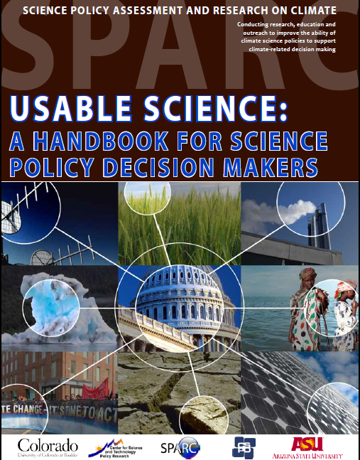
How to Decide what Science to Do
Science best meets the needs of decision makers when those needs are considered throughout the Institutions, Policies, and Processes of Decisions about Science

Slide 4
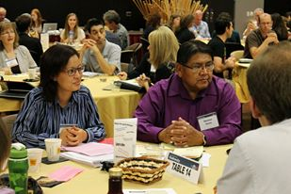
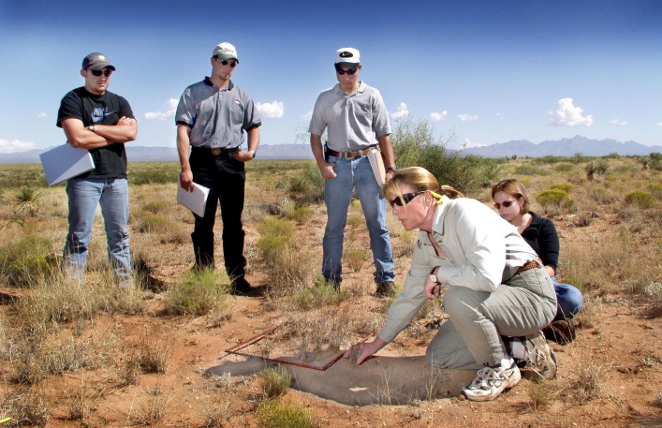
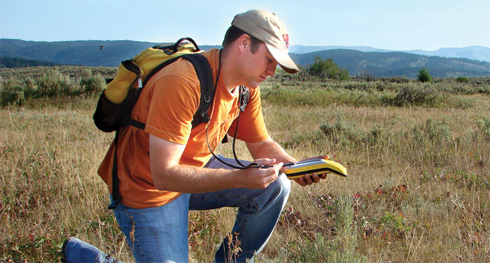

Slide 5
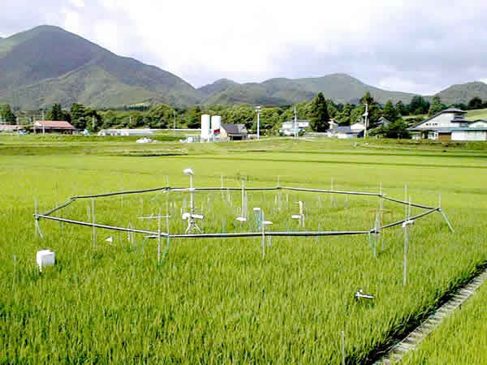
Myths that get in the way of
usable science
Usable science = applied research

Slide 6
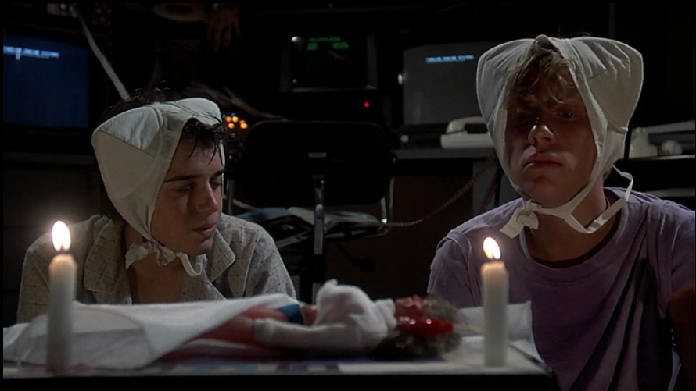
Myths that get in the way of
usable science
The benefits of science are unpredictable
Weird Science, Universal Pictures 1985

Slide 7
Myths that get in the way of
usable science
Big Vat o’ Knowledge
Decisionmakers benefit from science at the end of the research process

Slide 8

Myths that get in the way of
usable science
More research is always better

Slide 9
Reconciling the Supply of and Demand for Science
 |  | Demand: Can Users Benefit from Research?
 |  | YES | NO
Supply: Is Relevant Information Produced? | NO | Research agendas may be inappropriate | Non-user
 | YES | Empowered users taking advantage of well-deployed research capabilities | Disenfranchised or marginalized users, institutional constraints, or other obstacles prevent information use
Notes:
Conceptualize as problem of managing science for decision making in terms of relationship between supply of science information and demand for usable information
Ensuring the supply of scientific information is in line with needs of decision makers/ users requires attentive management
No invisible hand of science
Relate the mission, goals, and results of research to specific on-the-ground problems
Establish ongoing processes to engage with and seek to understand needs of users
Incorporate needs of users into practice of science funding and science management
Test and evaluate results of research intended for use

Slide 10
Characterizing Supply of Science
What factors steer science?
What kind of knowledge is most helpful?
To produce science for decision making, need to recognize the differences between research to advance discipline vs research to solve a problem

Slide 11
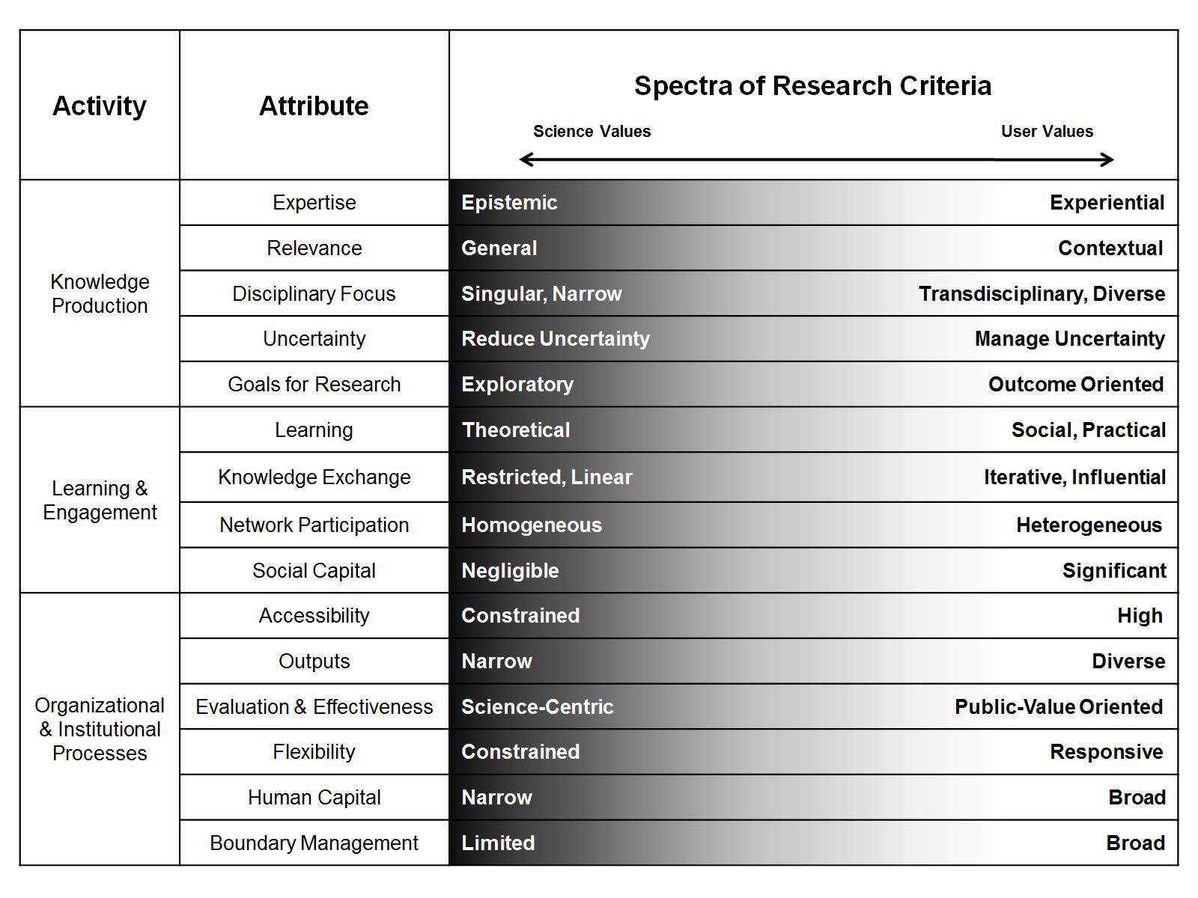

Slide 13
Understanding the Demand for Science
Societal Problem
Knowledge Users
Outcomes
Notes:
In understanding the demand for science, need to
Carefully define the broad societal problem for the research to address
Define the specific categories or groups of users to be involved
Identify the outcomes that would represent progress from user’s perspective – do this with the user!

Slide 14
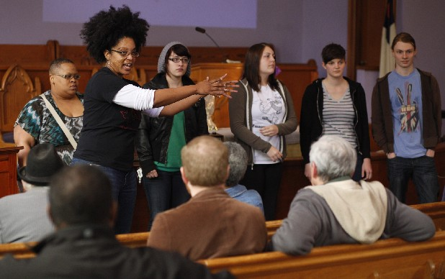
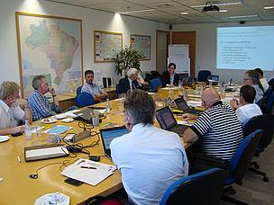
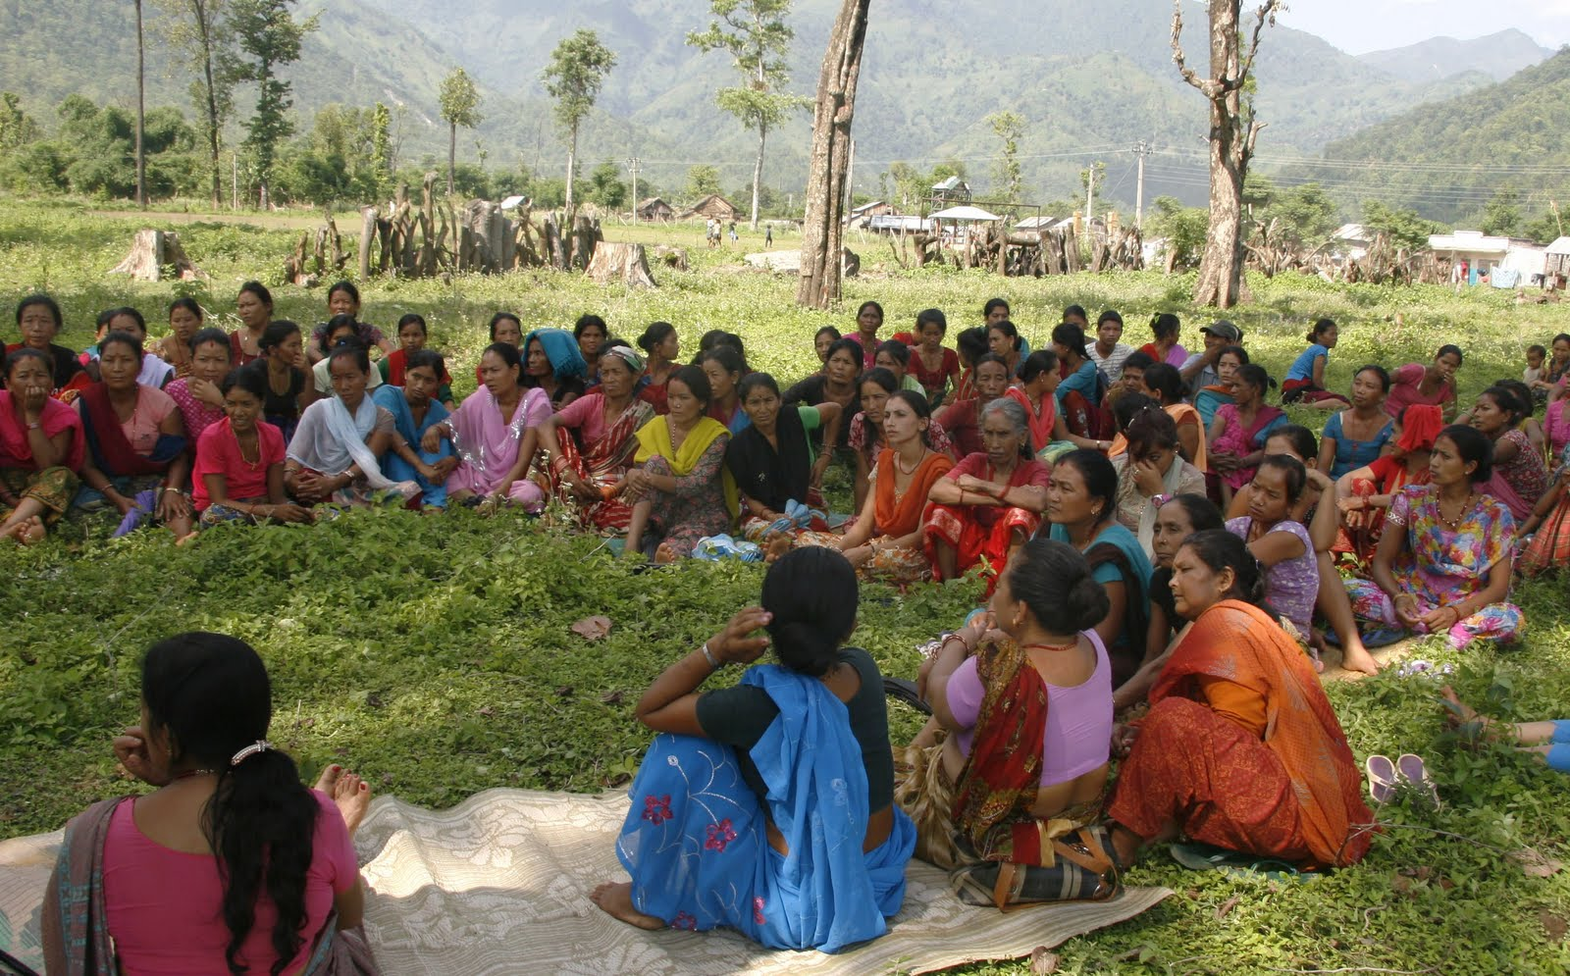
Notes:
These are all linked so this will be an iterative process of continual adjustment as knowledge advances, user needs change, and understanding of the problem evolves. And require the development of relationships and trust between researchers and users

Slide 15
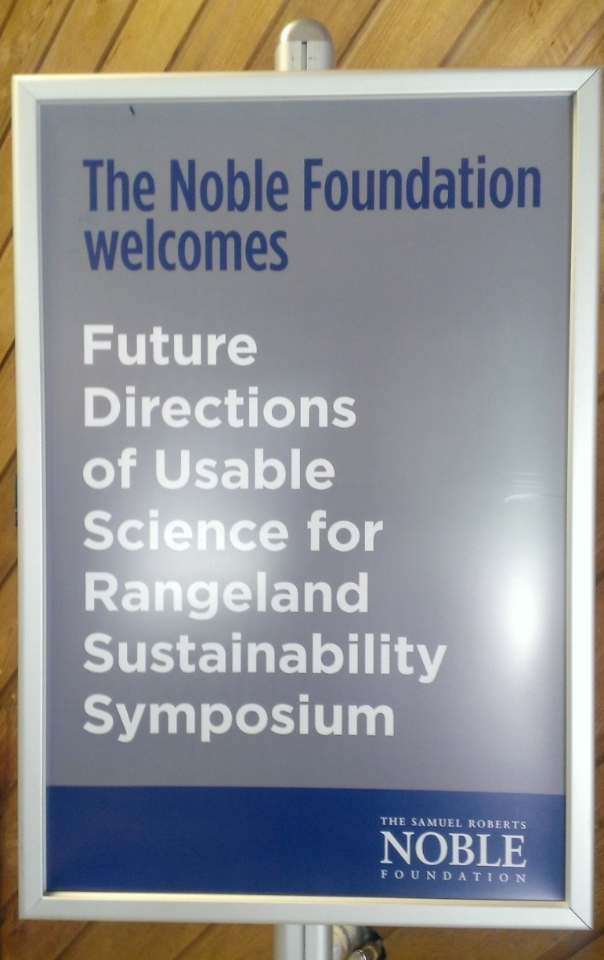
Future Directions for Usable Science
for Rangeland Sustainability, June 2-5, 2014
Sustainable Rangelands Roundtable
The Samuel Roberts Noble Foundation
Consortium for Science, Policy & Outcomes at Arizona State University
University of Wyoming, Department of Ecosystem Science and Management
Colorado State University
National Cattlemen’s Beef Association
National Grazing Lands Coalition
Oklahoma State University
Sand County Foundation
Texas A&M University
The Nature Conservancy
University of Arizona
University of Nevada – Reno
University of Wyoming
Utah State University
USDA Agricultural Research Service
USDA Forest Service
USDA National Institute for Food and Agriculture
USDA Natural Resources Conservation Service
USDI Bureau of Land Management
US Geological Survey

Slide 16
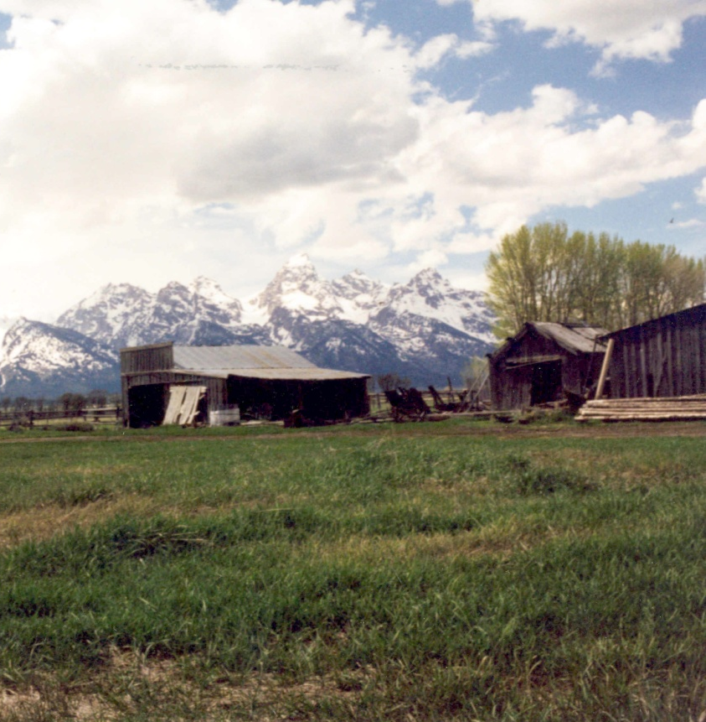
Rangeland Sustainability
Integrates social and economic aspects of human well-being with ecosystem integrity, and environmental limits and capacities.
Reflects shifting social values and economic development geared toward resource conservation. Integrates current and potential future values.

Slide 17
Future Directions for Usable Science
for Rangeland Sustainability
Define and discuss the concept of usable science as it pertains to rangeland health and sustainability
Identify current and emerging issues facing rangelands and their sustainable management and important stakeholders for each
Develop a portfolio of recommendations for future directions of usable science for rangeland sustainability, incorporating stakeholder input to address soil health, water, plants, animals, and socio-economic aspects of sustainable rangelands and the varied ecosystem goods and services that they provide

Slide 18
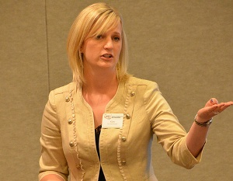
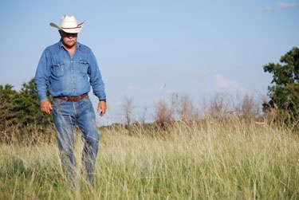

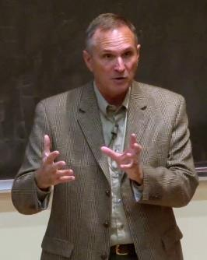
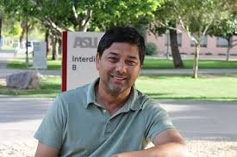
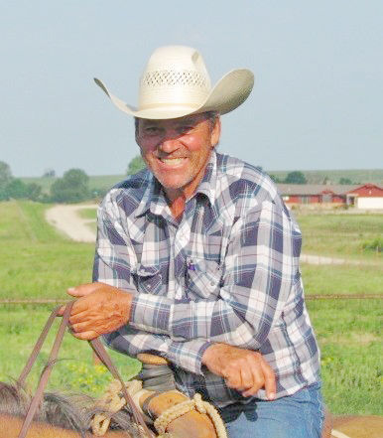
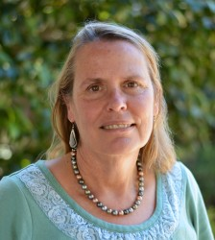
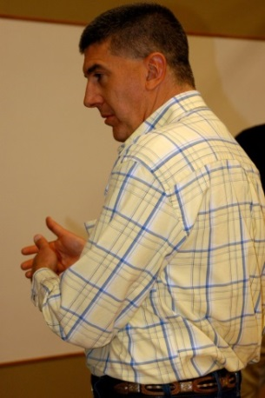
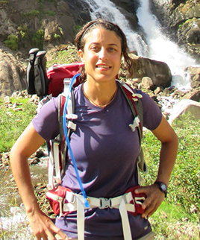
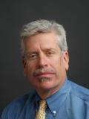

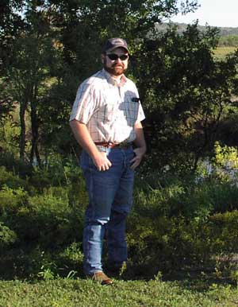
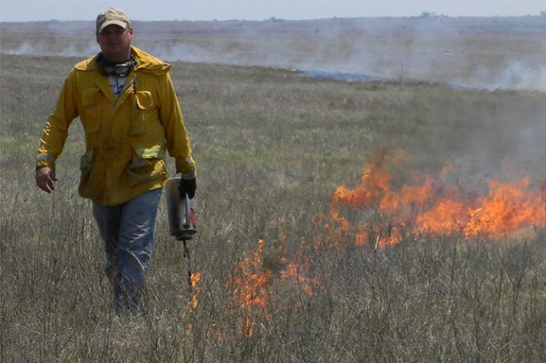
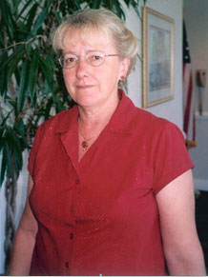
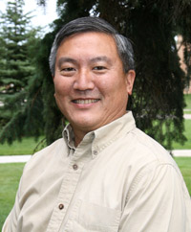

Slide 19
Workshop Process
Five workgroups – soil health, animals, vegetation, water, and socio-economic
Brainstorm ideas, issues and challenges confronting sustainable rangelands
Whole group then ranked the importance of each of the 142 identified issues as high (1), medium (3), or low (5)
Responses then collated and a comprehensive, ranked list of issues was created
Groups met to flesh out priority issues to be addressed in near-term, identify stakeholders for these issues and develop research questions/areas to do so
Priorities and research directors further refined in discussion with the whole group

Slide 20
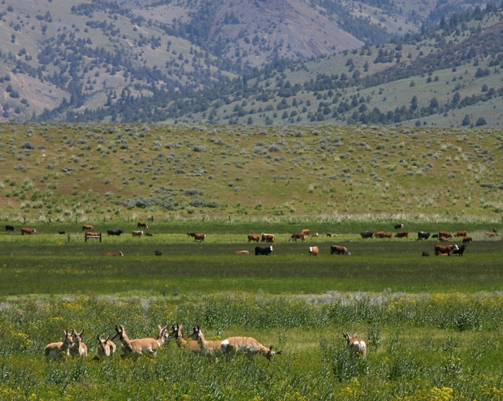
Lori Hidinger
Managing Director, Consortium for Science, Policy & Outcomes
School for the Future of Innovation in Society
Arizona State University
www.cspo.org @lorihidinger @CSPO_ASU
Booth #442

